Slide 1
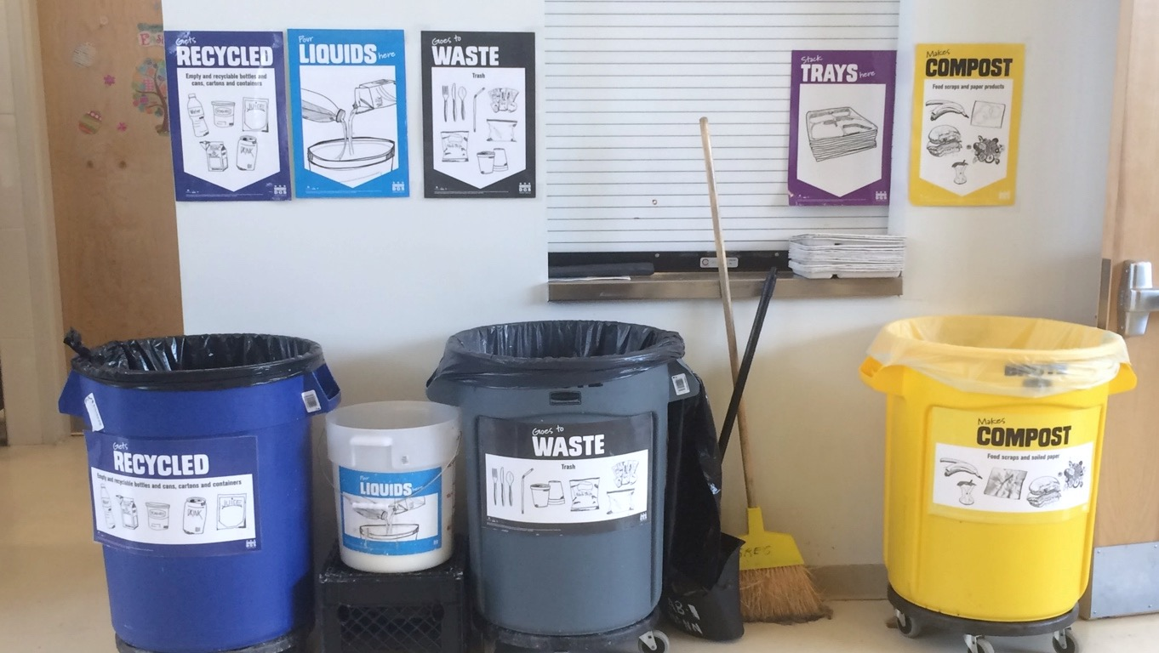
[insert your school name] RECYCLES!
DCPS Recycles!
All-Staff Introduction
2017-2018
Updated July 2017

Slide 2
The DCPS Recycles! Program
All DCPS schools are legally required to recycle
All staff and students are responsible for sorting materials correctly.
Custodial staff is responsible for collecting waste to dispose into the correct outdoor containers for pick up.
They are NOT expected to sort waste that has been improperly sorted.
When someone puts trash in a recycling bin, everything in the bin will have to go to a landfill or incinerator.

Slide 3
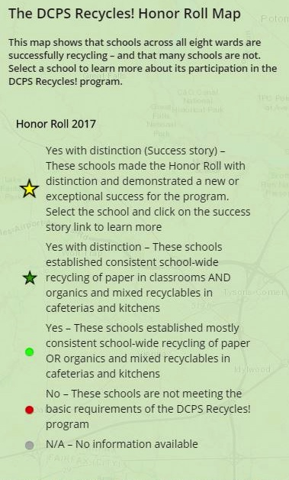
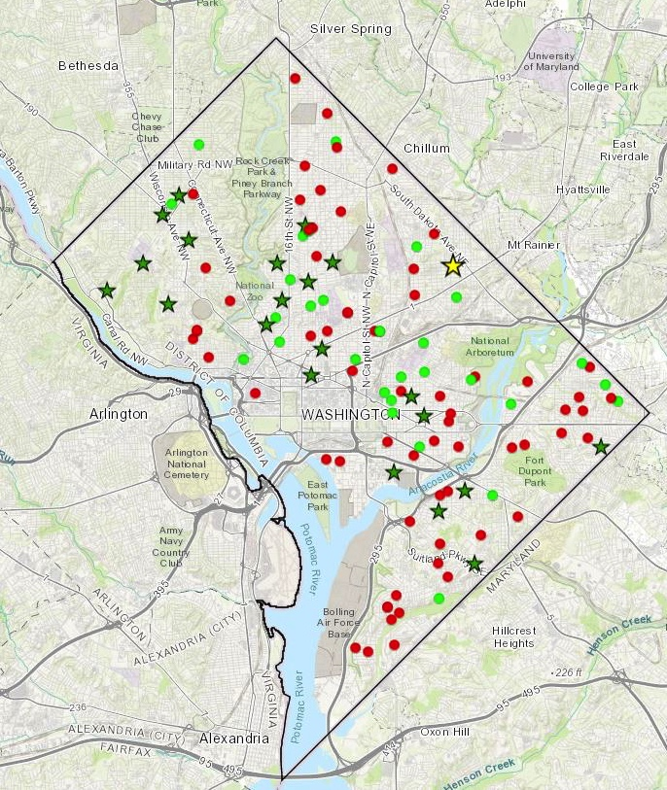
DCPS Recycles! Honor Roll
In 2017…
55 schools made the DCPS Recycles! Honor Roll.
25 schools made the Honor Roll with Distinction
This year, we will be one!

Slide 4
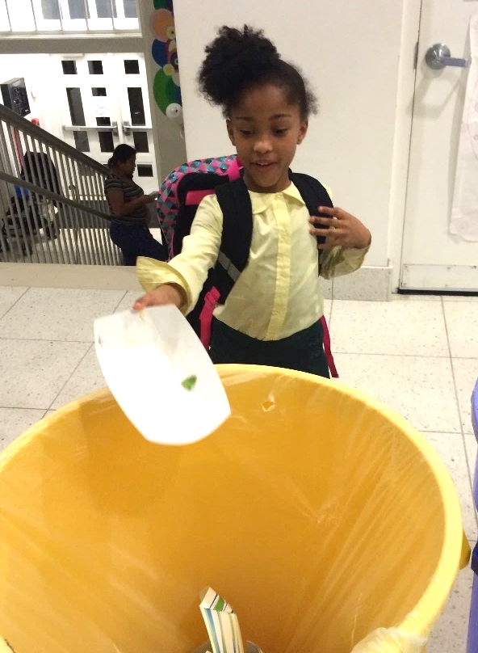
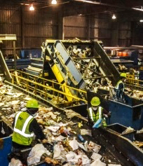
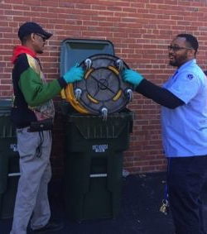
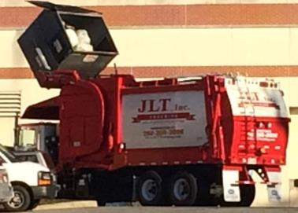
Let’s Recycle! How to Recycle at School
EVERYONE
CUSTODIANS
HAULER
FACILITY
sorts
collect
transports
processes

Slide 5
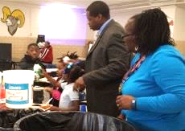
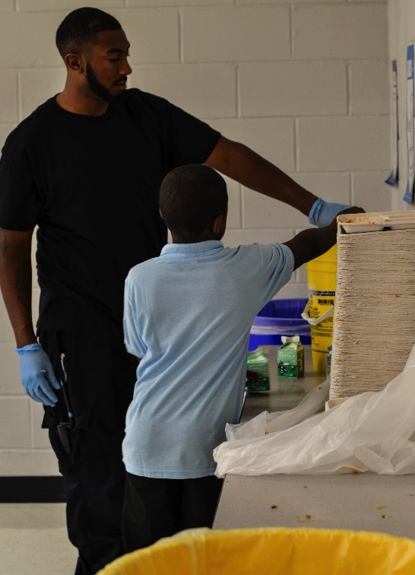
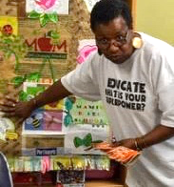
Let’s Recycle! It takes teamwork
LEADERSHIP
OPERATIONS
EDUCATION
Notes:
The operations team (custodial staff), leadership (principal, AP), and educators (teachers and aides) must work together for the recycling program to succeed. If anyone doesn’t do their part, everyone else’s hard work goes to waste! (Punny!)

Slide 6
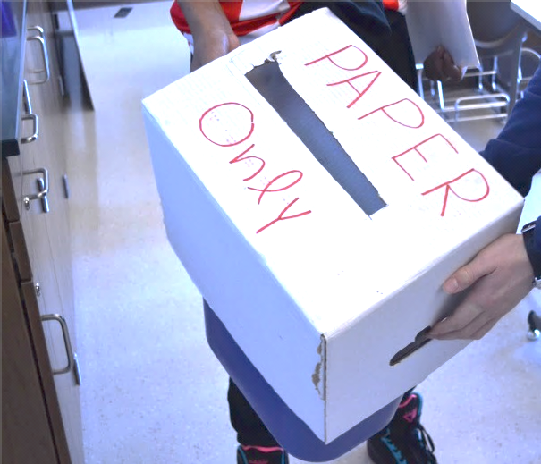
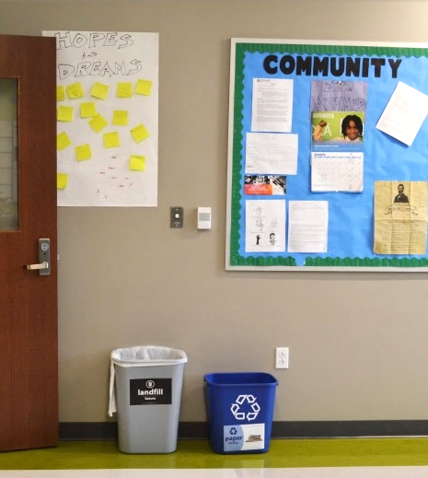
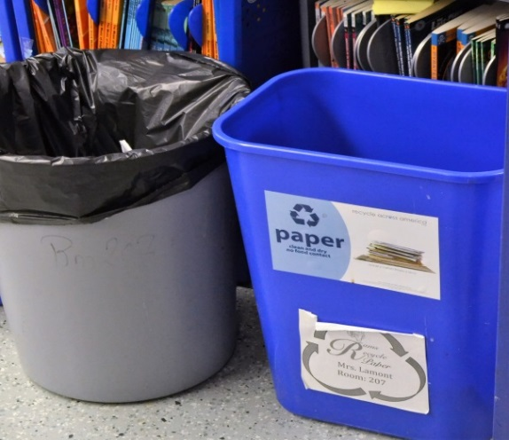
Let’s Recycle in our Classrooms + Offices: Paper Recycling Only
Use BLUE bins for clean, dry paper only
These things do NOT belong in the paper bin:
Tissues
Napkins
Paper towels
Cafeteria trays
Greasy paper
Milk cartons
Food Waste
Plastics
Glass
Metal
Teachers are responsible for ensuring students in their classroom sort properly
Classrooms and offices should have a blue bin labeled for PAPER ONLY and a black bin for trash
Notes:
Mixed recyclables are collected separately. Why? Clean paper can be made into more clean paper! If it gets messy from food, drinks, or other things, it would just make more dirty paper!

Slide 7
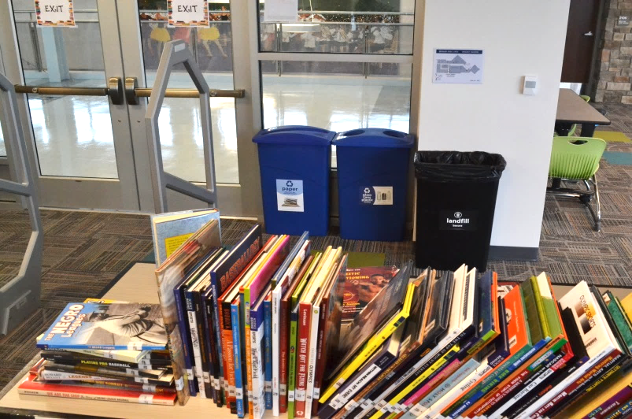
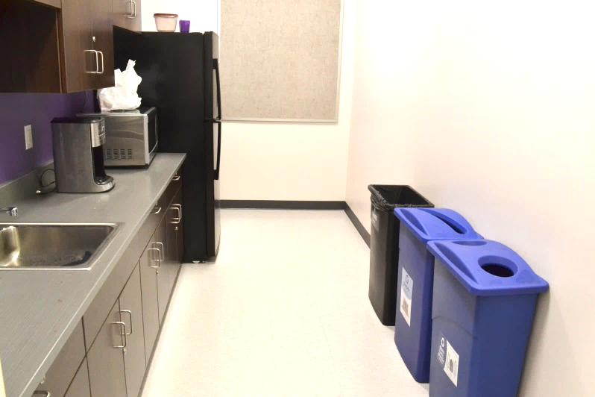
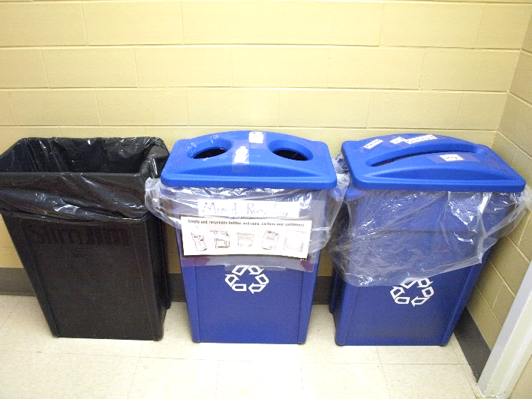
Let’s Recycle in our Common Areas: Paper + Mixed Recycling
Common areas should have a blue bin labeled for PAPER ONLY, a blue bin labeled for BOTTLES and CANS, and a black bin for trash.
Empty food and beverage containers should before recycling them.
Recycle items according to labels on bins.
Remember that plastic films (e.g. grocery bags and sandwich bags) are not recyclable.

Slide 8
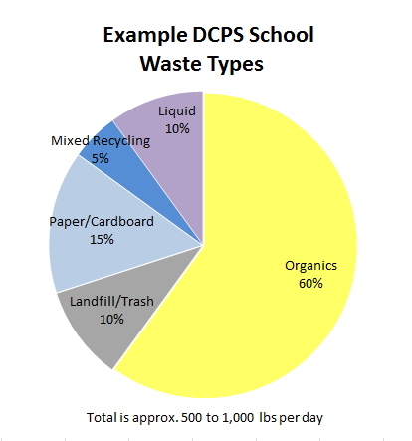
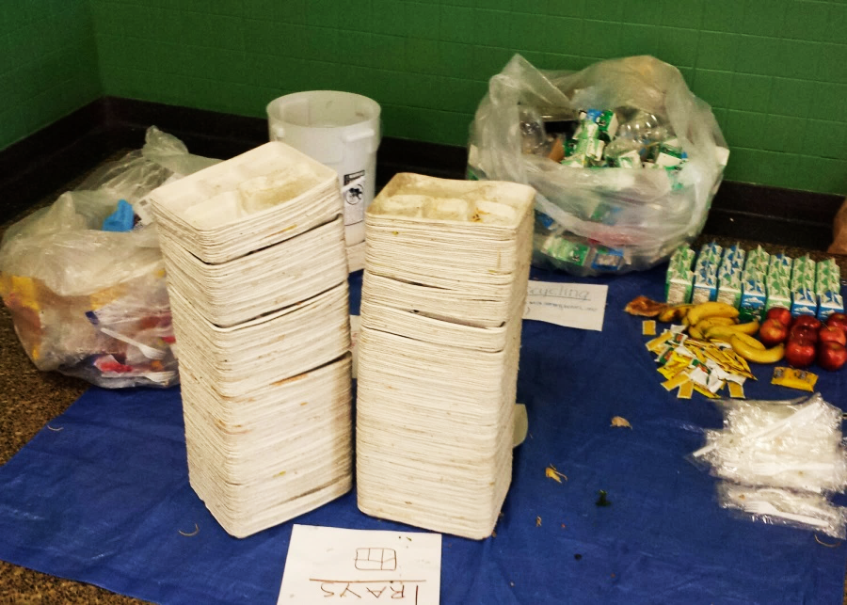
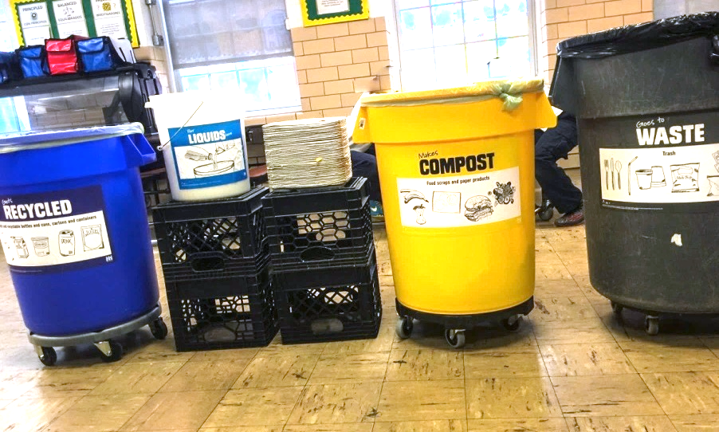
Let’s Recycle in our Cafeteria: Organics + Mixed Recycling
Why should we recycle in our cafeteria?
More than 75% of waste in the cafeteria is recyclable.
Notes:
Think about why we recycle

Slide 9
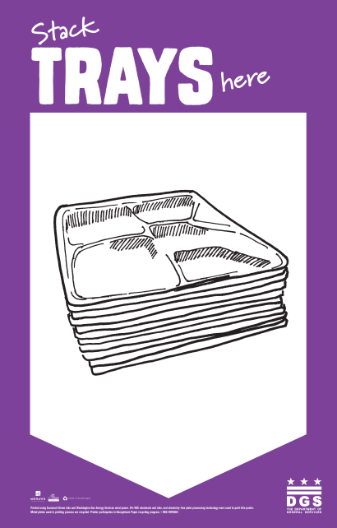
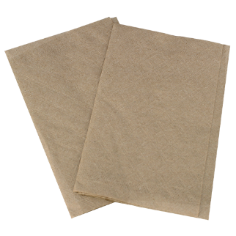
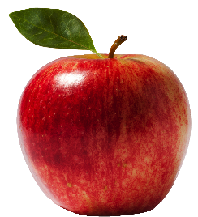
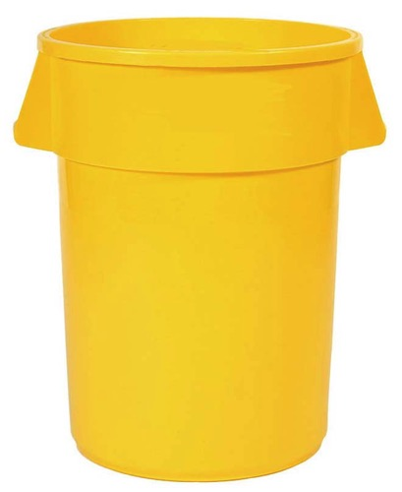
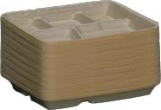
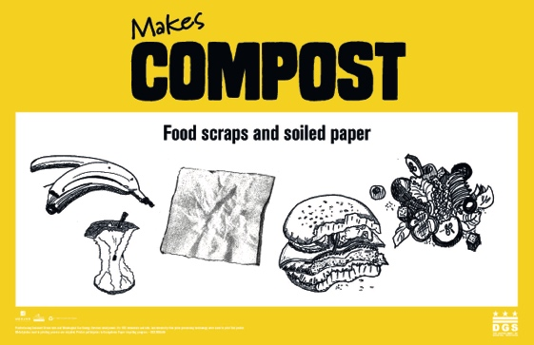
What goes in the YELLOW bin?
Let’s Recycle in our Cafeteria: Organics
Use yellow bins to recycle food scraps and soiled paper (compostable waste)
Acceptable Materials:
ALL food products (including meat, cheese, citrus, greases)
Napkins/paper towels
Cardboard food containers
Paper trays (stacked)
Students stack empty trays to save space in the bins and a lot of time for custodial staff!
NO PLASTIC allowed!

Slide 10
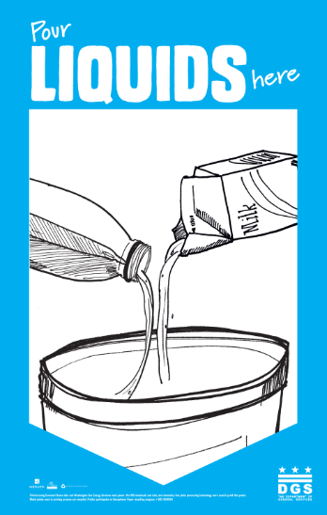
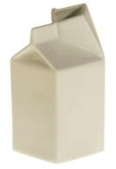
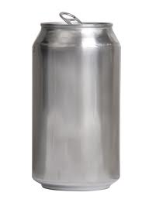
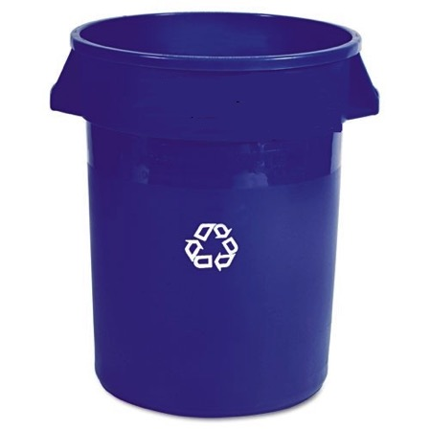
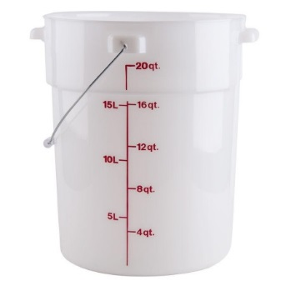
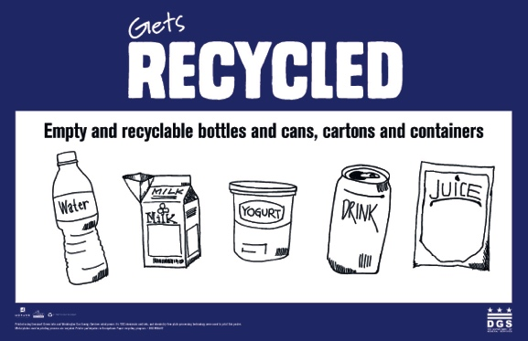
Let’s Recycle in our Cafeteria: Mixed Recycling
What goes in the BLUE bin?
Then you can RECYCLE!
Containers need to be clean and empty before they can be recycled
For food containers (e.g. yogurt), it is “empty enough” if you can turn it upside down and nothing comes out
Recycle milk cartons with mixed recyclables - not with paper - because they are lined with plastic and have liquid residue on them
Acceptable materials include rigid plastics and metal containers. See the Mayor’s List to learn more!
Empty liquids into bucket…

Slide 11
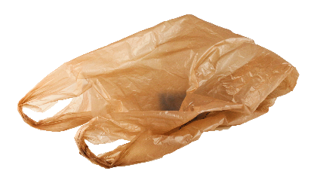
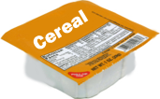
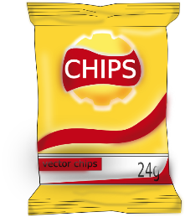
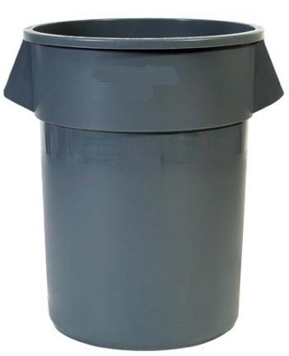
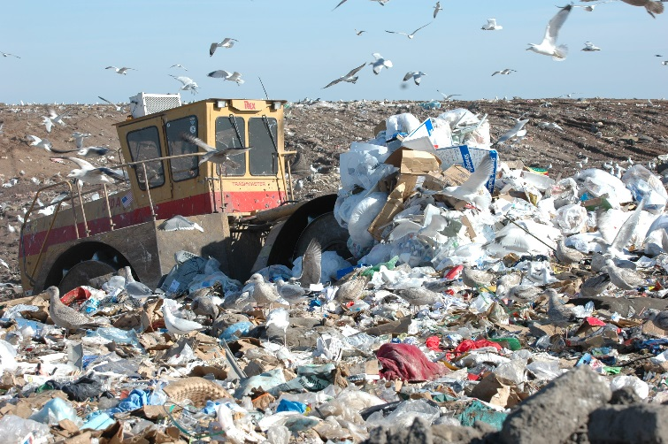
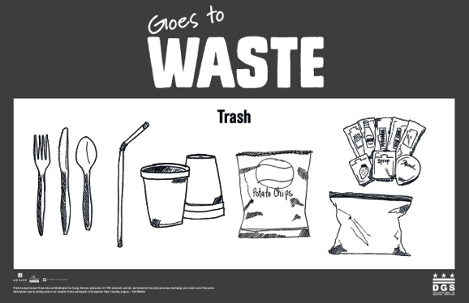
What goes in the GREY bin?
Let’s Recycle in our Cafeteria: Trash – “When in doubt, throw it out!”
All other materials go to waste! They will get sent to a landfill or incinerator.
Small plastic items (less than 2”x 2”) such as utensils and straws fall through the cracks at recycling facilities and end up being sent to a landfill anyway.
Flexible plastic materials that you can easily ball up in your hands, such as plastic bags, get tangled in the recycling machines.
Styrofoam is not recyclable.
If you are unsure of which bin something should go in, the waste bin is the default choice.
Image: Onslow County Government

Slide 12
Anyone can advocate and innovate!
What else can you do? The options are endless!
Talk to one of your recycling team leaders if you have questions:
<<INSERT NAMES OF 3 DELEGATES>>
Teachers can contact DGS for ideas about connecting recycling with classroom learning.
Food Recovery!
Gardening Education!
Field Trip!
DGS Contact: Beth Gingold, Beth.Gingold@dc.gov
https://dgs.dc.gov/page/dgs-healthy-schools

