Slide 1
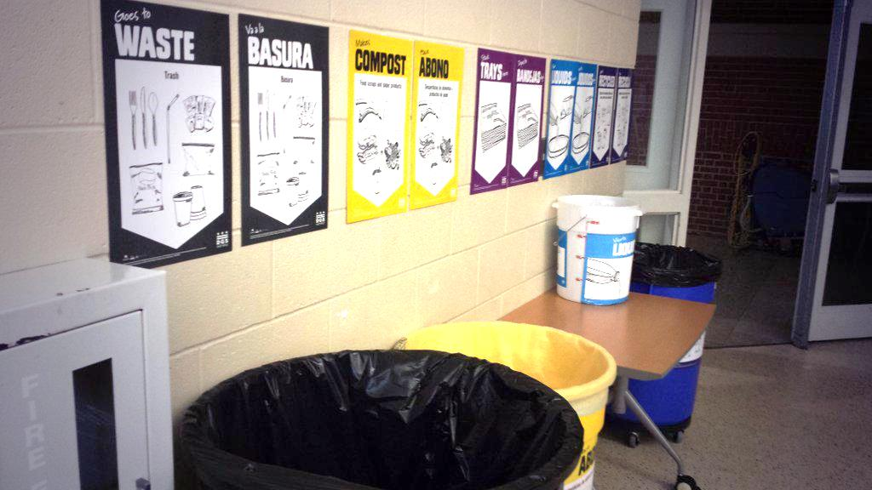
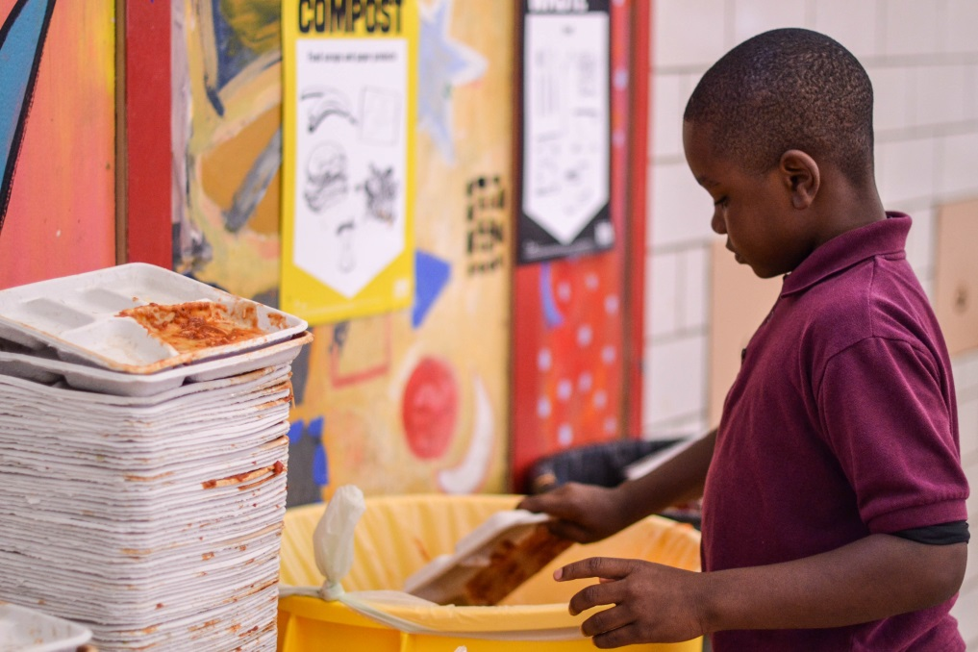
DCPS Recycles! 2015-2016 All Staff Introduction
Updated August 7, 2015

Slide 2
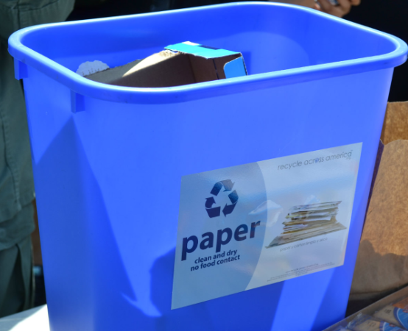
The DCPS Recycles! Program aims to:
Fulfill legal requirements
Improve building operations
Reduce waste of money and natural resources
Achieve the SustainableDC target of zero waste by 2032
Teach DCPS students values and skills for a sustainable 21st century

Slide 3
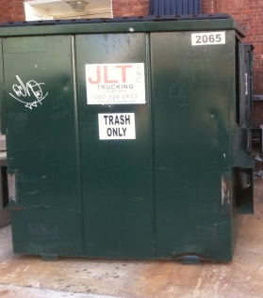
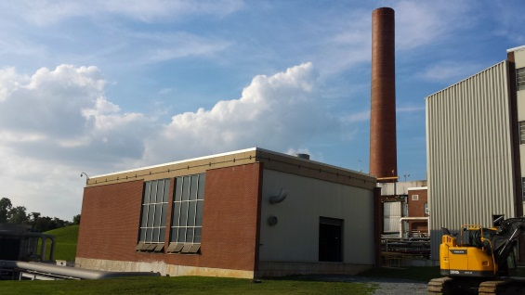
Waste doesn’t just disappear!
If you just “throw away” your “trash” in DC it ends up being burned in an incinerator or buried in a landfill.

Slide 4
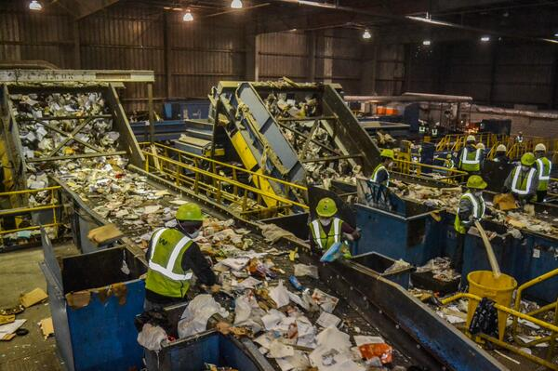
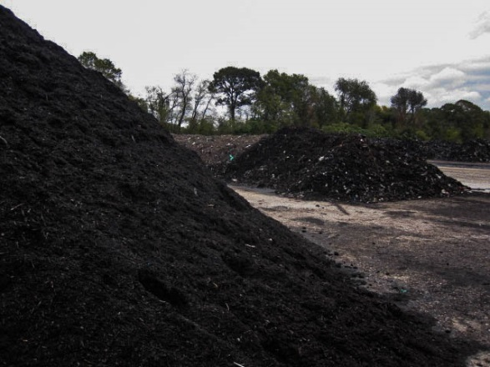
Our goal is to sort all our waste properly so as much as possible can be recycled or composted instead of sent to a landfill or incinerator!
Recycling Facility – Elkridge, MD
Composting Facility – Upper Marlboro, MD
Notes:
All DCPS schools are to sort organics, paper recyclables, mixed recyclables, and non-recyclable trash into the correct outdoor containers so that they can be picked up and processed properly.
When schools sort correctly, organics and recyclable materials are turned into valuable compost and new products instead of wasting space in a landfill or making pollution by being burned in an incinerator. The District makes money back from selling clean paper recyclables.

Slide 5
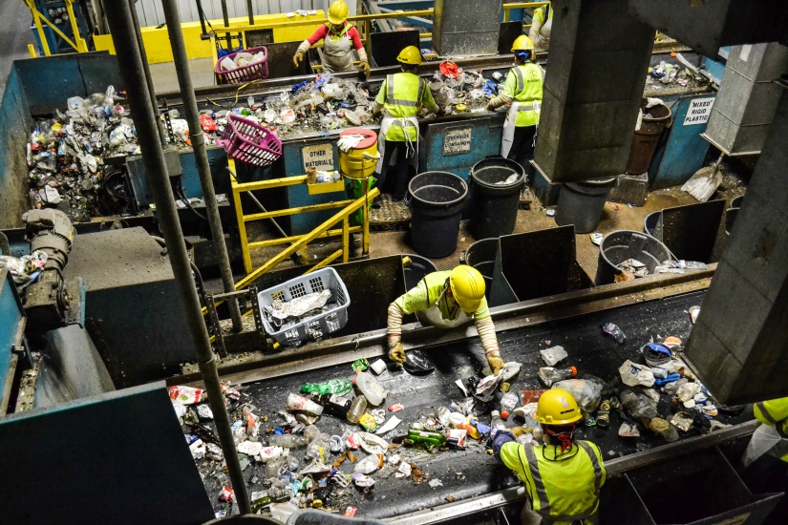
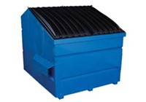
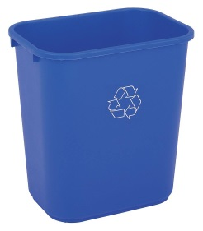
Recycling right means that the right materials get to the right facilities!
All school staff and students SORT waste into the right bins
Custodial staff COLLECT waste into the right dumpsters
Trucks TRANSPORT waste to the right facilities

Slide 6
Last year, 52 schools made the DCPS Recycles! Honor Roll for recycling right!

Slide 7
Recycling right requires teamwork
The administrator responsible for communicating the school-wide plan to all staff, setting school-wide goals, and delegating roles and responsibilities to both teaching and operations staff
Our Team Leaders:
Administrator: [INSERT NAME HERE]
Operator: [INSERT NAME of FOREMAN HERE]
Educator(s):[INSERT NAME HERE]
The maintenance team is responsible for collecting materials for proper disposal
Staff member(s) who will take responsibility for the school's plan for communicating the program to all students and explaining the "why" to other school staff

Slide 8
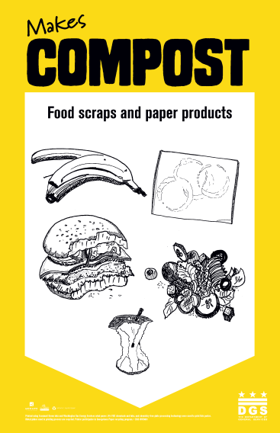
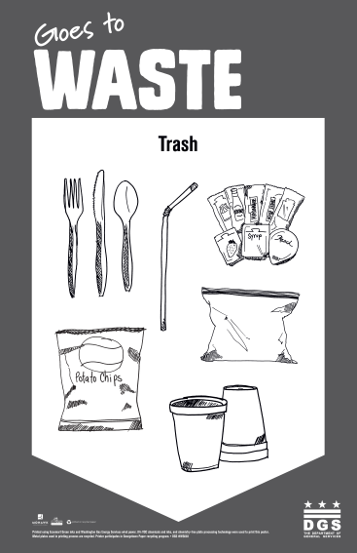
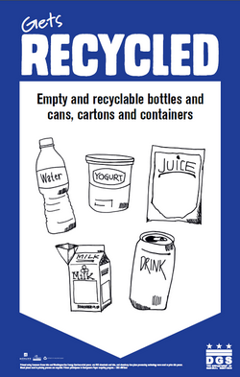
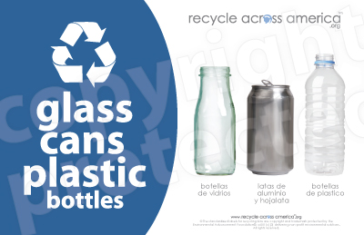
Everyone is expected to participate – this means to SORT properly
Look for signs and labels
In classroom and offices
In cafeteria
In common areas

Slide 9
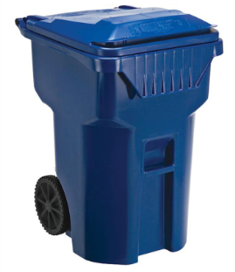
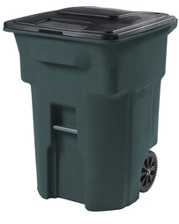
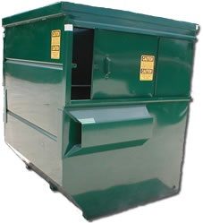
Custodial staff are responsible for COLLECTION, not sorting
Custodial staff are responsible for collecting waste into the correct outdoor containers for pick up.
Custodial staff are NOT expected to sort waste that has been improperly sorted by staff or students.
When someone puts trash in a recycling bin, everything in the bin becomes trash.
Please help the custodial staff by sorting properly.
Paper recyclables
Mixed recyclables
Organics
Trash

Slide 10
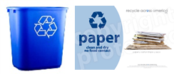
Classroom/office recycling
Classrooms and offices should have a BLUE bin labeled for PAPER ONLY and a BLACK bin for trash.
Teachers are responsible for ensuring students in their classroom sort properly.
Use BLUE bins for clean, dry paper only, as labeled!
Not all paper is recyclable
Mixed recyclables are collected separately!
Do NOT contaminate with: napkins, paper towels, cafeteria trays, milk cartons, food waste, greasy paper, plastics, glass, metals.

Slide 11
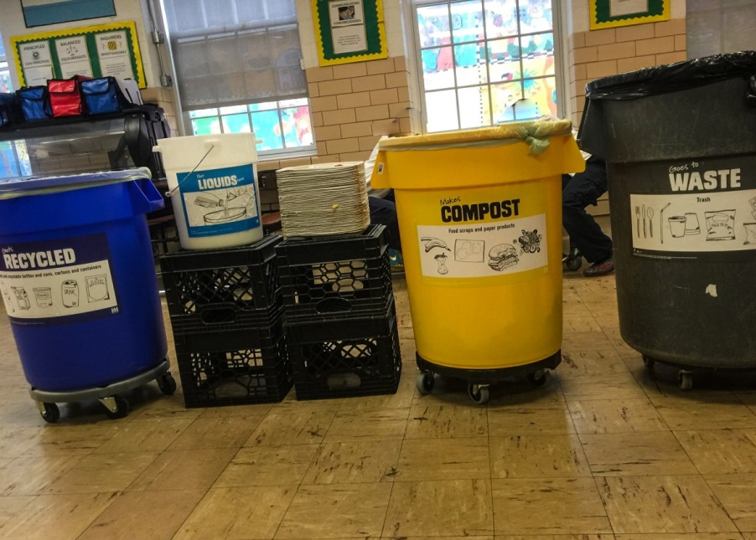
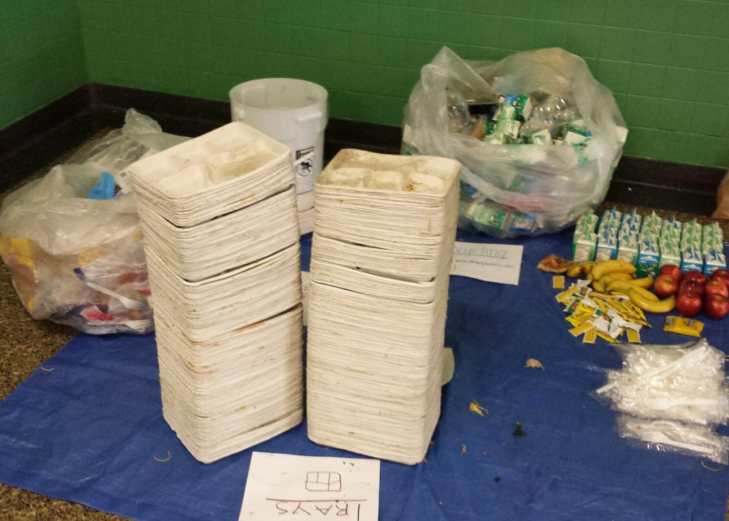
Coming soon: Organics recycling!
More than 75% of DCPS cafeteria waste is compostable or recyclable, according to waste studies conducted with students.
Our school will begin recycling food waste in the cafeteria on [insert date here]
Cafeteria Sorting Station
School Lunch Waste Audit

Slide 12
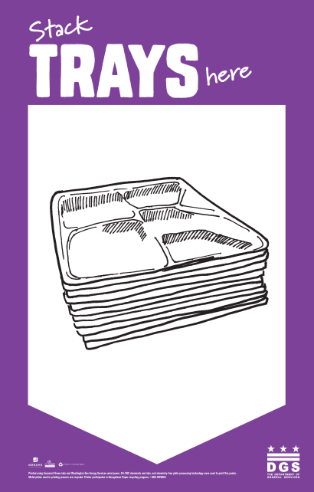
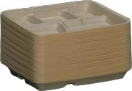
Organics Recycling in the Cafeteria
Food scraps and soiled paper (compostable waste) can be recycled in yellow bins
Acceptable: ALL food products (including meat, cheese, greases), napkins, paper towels, cardboard food containers
Students stack empty trays. Trays are compostable and stacking saves space in the bins and a lot of time for custodial staff!

Slide 13
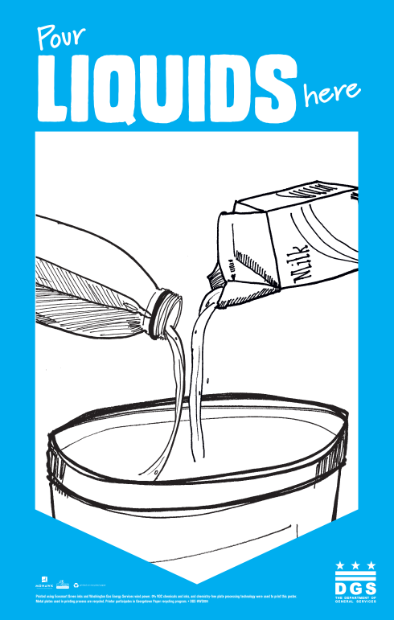
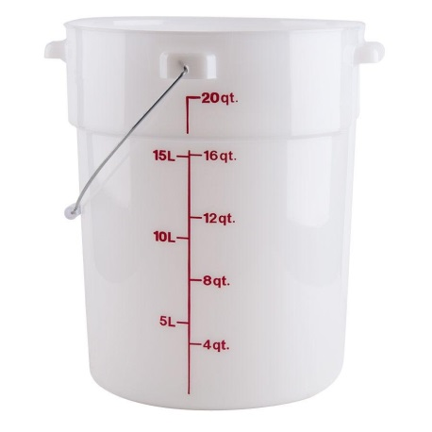
Mixed Recycling in the Cafeteria
Recyclable containers need to be empty before they can be recycled
Empty liquids into bucket
For food containers (e.g. yogurt), it is “empty enough” if you can turn it upside down and nothing comes out
Milk cartons are to be recycled with mixed recyclables - not with paper - because they are lined with plastic and have liquid residue on them

Slide 14
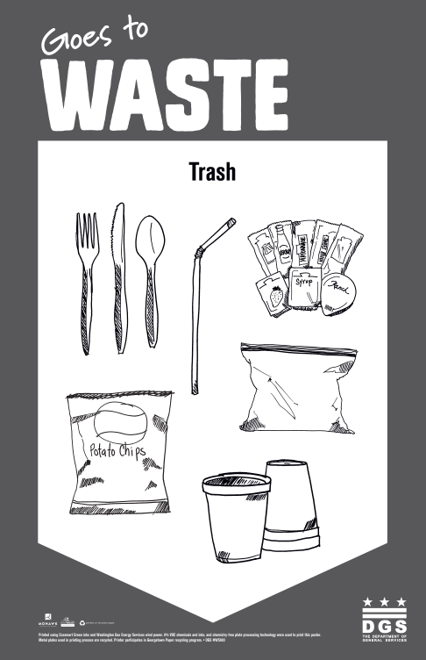
Other materials end up going to waste! (in an incinerator or landfill)
Small plastic items such as utensils and straws fall through the cracks at recycling facilities and end up being sent to a landfill anyway.
Plastic materials that you can easily ball up in your hands, such as plastic bags get tangled in the machines so are not accepted by our recycling facilities.
Styrofoam is not recyclable.
If you are unsure of which bin something should go in, the waste bin is the default choice.
“When in doubt, throw it out!”

Slide 15
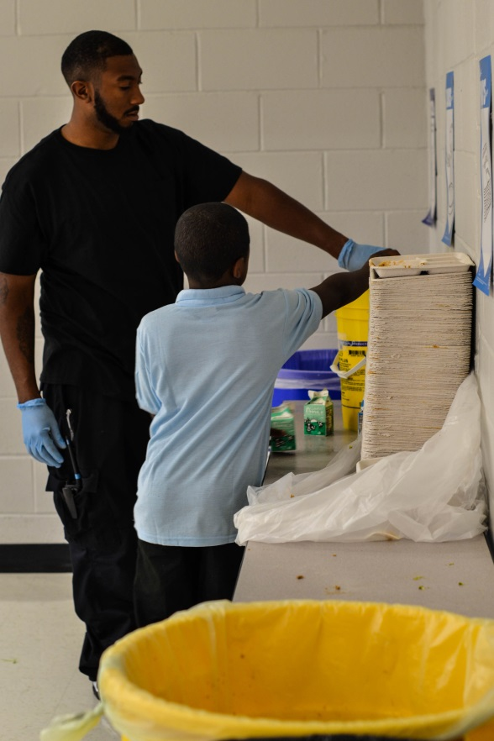
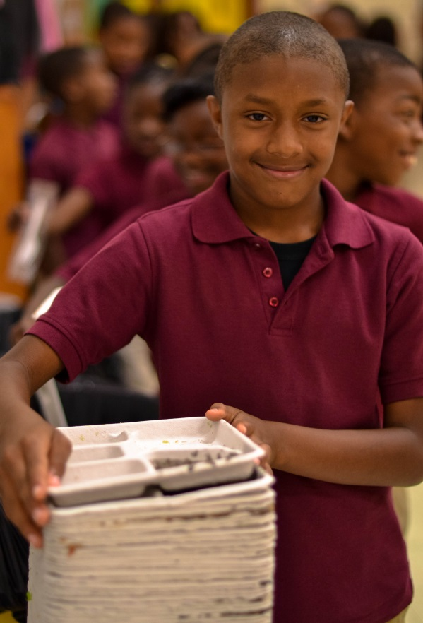
Anyone can advocate or innovate!
Please let [ insert team leader names here] know if you have questions or ideas!
Teachers: Contact DGS for ideas on involving students
DGS Contact: Beth Gingold, Schools Conservation Coordinator, beth.gingold@dc.gov, 202-727-3587

