Slide 1
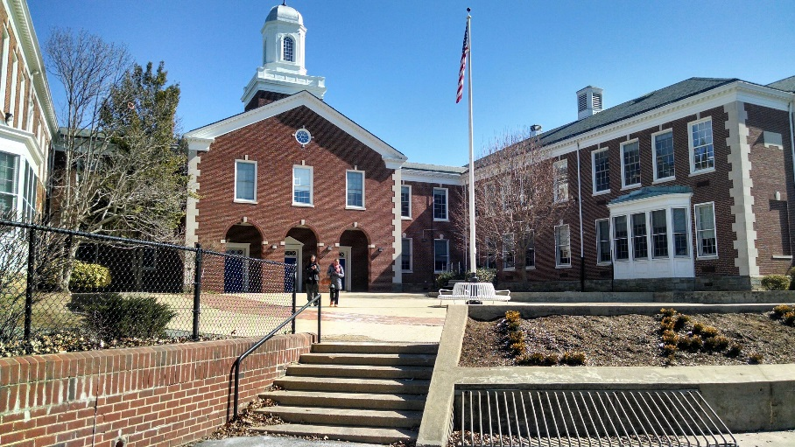
Elevating the Quality of Life in the District
LAFAYETTE ELEMENTARY SCHOOL MODERNIZATION
PROJECT UPDATE
DECEMBER 15, 2015

Slide 2
Elevating the Quality of Life in the District
Elevating the Quality of Life in the District
MEETING AGENDA
INTRODUCTIONS / “RULES OF THE ROAD”
WELCOME - DR. BROQUARD
MURCH SWING SPACE DISCUSSION & CONSIDERATIONS
Q&A
NEXT STEPS
FIELD DISCUSSION
Q&A
NEXT STEPS

Slide 3
Elevating the Quality of Life in the District
Elevating the Quality of Life in the District
RULES OF THE ROAD
CELLPHONES OFF OR ON VIBRATE
RESTROOMS
RESPECT EACH OTHER OPTIONS
THE MEETING WILL RUN FROM 7PM TO 9PM
Q&A WILL BE TAKEN AT THE END OF EACH SECTION OF THE PRESENTATION
EACH SPEAKER WILL BE GIVEN 30 SECONDS
PLEASE TAKE A NUMBER FOR YOUR TURN TO SPEAK
COMMENTS / QUESTIONS WILL BE DOCUMENTED
COMMENTS CARDS:
YELLOW – MURCH ES @ LAFAYETTE ES FIELD
GREEN – FIELD MATERIAL

Slide 4
Elevating the Quality of Life in the District
Elevating the Quality of Life in the District
COMMUNITY UPDATES
WORK HOURS
Hours – 7am – 7pm, Mon – Sat
Occasional needs to work after hours will be shared via email
MURCH ES SWING SPACE CONSIDERATIONS
FIELD LAYOUT / PERMITTING / MATERIALS
– Will be presented at Community Meeting in early January 2016

Slide 5
Elevating the Quality of Life in the District
Elevating the Quality of Life in the District
MURCH ES SWING SPACE CONSIDERATIONS
Safety & Security
Impact on Instruction
Proximity to Murch ES
Impact on Community
Transportation Logistics
Parking
Play space
Cost
Procurement, Permitting and Construction duration

Slide 6
Elevating the Quality of Life in the District
Elevating the Quality of Life in the District
MURCH ES SWING SPACE CONSIDERATIONS
OPTIONS BEING CONSIDERED (NOT IN ORDER OF PREFERENCE)
On-Site @ Murch ES (~$2.5M)
Split On-Site & Nearby Capital Memorial Church (~$3.6M)
UDC Soccer Field (~$6M)
Lafayette Swing Space (~$4.5M)
ADDITIONAL PROPERTY OWNERS CONTACTED:
4001 Brandywine St (Office Building)
5252 Wisconsin Ave (Commercial)
Intelstat
Fannie Mae
American University
Howard University Law School
Fillmore School
Wesley Theological Seminary
Christ Church of Washington
Jackson School Art Center

Slide 7
Elevating the Quality of Life in the District
Elevating the Quality of Life in the District
MURCH ES SWING SPACE CONSIDERATIONS
KNOWN CHALLENGES WITH MURCH AT LAFAYETTE FIELD
~1400 students on one site
Play Space
No field for 2+ additional years
No 5-12 year old play structure for two years
Large number of kids on the DPR play equipment.
Tough to coordinate recess.
Emergency Evacuation Logistics
Parking concerns / Traffic concerns, especially at pick up and drop off.
Community impact
Utilities Capacity to support both schools
Impact on Lafayette Rec Center Construction Schedule

Slide 8
Elevating the Quality of Life in the District
Elevating the Quality of Life in the District
MURCH ES SWING SPACE CONSIDERATIONS
The Lafayette School and Community started a survey to receive feedback on the school and community. The results of the survey as of 3:00 PM on 12/15/15 are shown below.
Support of Murch in Lafayette Trailers (# of responses/% of total)
-- Strongly Oppose: 649 / 88.9%
– Somewhat Oppose: 46 / 6.3%
– Neutral: 7 / 0.96%
– Somewhat Support: 8 / 1.10%
– Strongly Support: 20 / 2.74%
Total Survey Respondents: 732

Slide 9
Elevating the Quality of Life in the District
Elevating the Quality of Life in the District
FEEDBACK METHODS
QUESTIONS / COMMENTS AT THE END OF PRESENTATION
COMMENTS CAN BE SUBMITTED BY 12/31/15 to:
Email: SIT.INFO@dc.gov
Lafayette ES Initiated Survey Link:
https://www.surveymonkey.com/r/YQYBVMB
COMMENT CARDS (COLLECTED AT THE END OF THE MEETING)
Yellow – Murch ES @ Lafayette ES Field
Green – Field Materials

Slide 10
Elevating the Quality of Life in the District
Elevating the Quality of Life in the District
MURCH ES SWING SPACE CONSIDERATIONS
DECISION PROCESS / TIMELINE
DGS will post summary of meeting notes by 12/18/15
Community can submit questions / comments until 12/31/15
DCPS will issue a summary of responses by 1/6/15
DCPS will evaluate each option taking into consideration community feedback
DCPS Senior leadership will make a decision by 1/12/16

Slide 11
Elevating the Quality of Life in the District
Elevating the Quality of Life in the District
Comments / Questions / Answers

Slide 12
Elevating the Quality of Life in the District
Elevating the Quality of Life in the District
QUESTIONS & ANSWERS
Take a number / Stay in your seat
30 second limit per speaker
Comment Cards are also available
Get Social with us on Facebook & Twitter Today!
Follow @DCDGS
Like us! @ Department of General Services (DGS)
Follow us! @ DCDGS
Become a Fan @DC Department of General Services

Slide 13
Contact Information
Kenneth Diggs
Associate Director, DGS Communications & Government Affairs
kenneth.diggs@dc.gov
202-580-9361
Jackie Stanley
DGS Communications & Government Affairs
Jackie.stanley@dc.gov
Website - dgs.dc.gov
Get Social with us on Facebook & Twitter Today!
Follow @DCDGS
Become a Fan @DC Department of General Services

Slide 14
***THE FOLLOWING SLIDES WERE NOT PART OF THE PRESENTATION OR WERE NOT PRESENTED DUE TO TIME LIMITATIONS.***

Slide 15
Elevating the Quality of Life in the District
Elevating the Quality of Life in the District
SITE STORMWATER MANAGEMENT
Modernization – Updates
Approximately $400k grant funding for green roofs to assist in meeting requirements
Cistern will be a part of the solution
Working to minimize bio-retention in SE corner of site
Working with DPR and DDOE to develop design.

Slide 16
Elevating the Quality of Life in the District
Elevating the Quality of Life in the District
CONCEPT STORMWATER MANAGEMENT PLAN

Slide 17
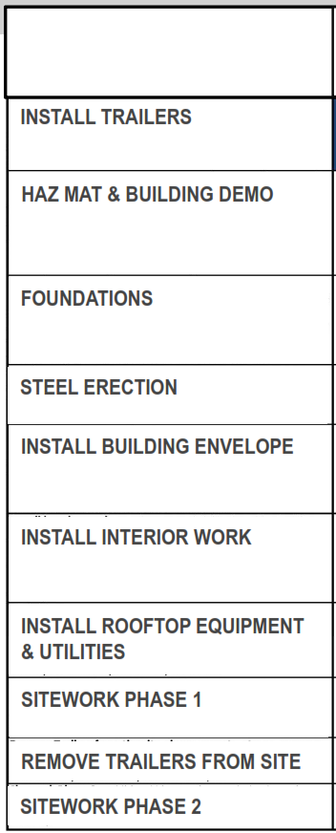
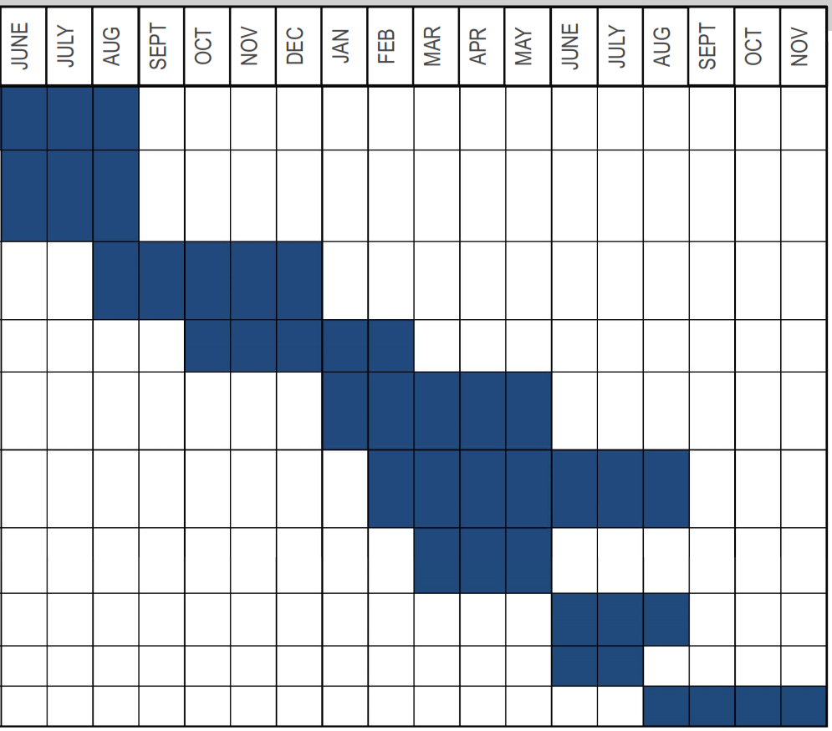
Elevating the Quality of Life in the District
Elevating the Quality of Life in the District
SCHEDULE OVERVIEW

Slide 18
Elevating the Quality of Life in the District
Elevating the Quality of Life in the District
DESIGN UPDATE
BZA / DDOT Submission
Presentation of proposed Variances / Request made to ANC Nov. & Dec., voted to support.
Storm Water Management Design
Working with DDOE, DPR, DC Water to finalize scope of work
Recent rainfall has provided ability to perform Hydrology study. A/E Team Reviewing Report.

Slide 19
Elevating the Quality of Life in the District
Elevating the Quality of Life in the District
FIELD LAYOUT / MATERIALS / PERMITTING
LAYOUT
Dugout Field with Backstop at North End
Grass Field with Backstop at South End
Materials Considered
Grass with Sub-drainage System
Artificial Turf
Permitting
DPR has the system set up for Permitting
MOU (Memorandum of Understanding) to be established to define school / DCPS used of the field

Slide 20
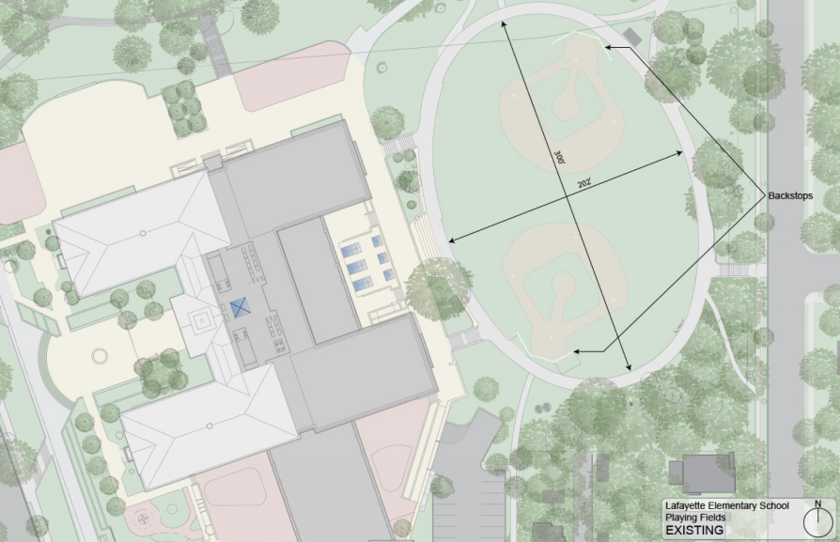
Elevating the Quality of Life in the District
Elevating the Quality of Life in the District
FIELD LAYOUT / MATERIALS / PERMITTING

Slide 21
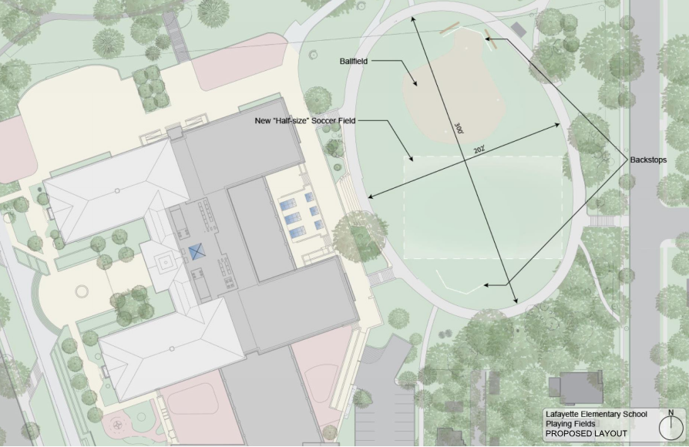
Elevating the Quality of Life in the District
Elevating the Quality of Life in the District
FIELD LAYOUT / MATERIALS / PERMITTING

Slide 22
Elevating the Quality of Life in the District
Elevating the Quality of Life in the District
NEXT STEPS & PROJECT SCHEDULE
December 2015 – Accept Comments /Questions from Community
January 2016 – Make decision on Murch ES Swing Space location
January 2016 – Finalize Field Material
January 2016 - Finalize SWM Design
Multi-Agency Coordination
January / February 2016 - Finalize Site Plan - Play Equipment
January/February 2016: Community Meeting
June 2015 – August 2016: Lafayette ES - Modernization Construction
DGS website updates and monthly notices sent to Lafayette teachers, parents, and community
Weekly emails sent to Neighbor Group with periodic additional emails for special notices

