Slide 1
Murch ES SIT February 11, 2016

Slide 2
Agenda
DCPS | OCOO
Swing Space Update
UDC Discussions
Logistics and Aftercare
Schedule
Murch Project
Update on Cost Estimate
Design Review
Schedule
Next Steps

Slide 3
Swing Space Update
DCPS | OCOO
Update on UDC Discussions
Updates on Swing Space Logistics & Aftercare:
Transportation: DCPS will be working with Murch leadership and parent volunteers to develop a survey to better understand transportation needs.
UDC Pick Up and Drop Off: DCPS has had conversations with DDOT about expanding the pick up and drop off area along Van Ness St. We will be conducting a site walk to finalize the plans.
Aftercare: DCPS will be meeting with representatives from X-Day, Capitol Languages Program, and Murch Leadership next week. Both programs have informally requested to share space in the trailers.
Move Coordination Meetings: DCPS and DGS will be working with the Murch leadership and staff to develop a moving plan. First meeting will be at the end of February. Contractors will be responsible for the move and providing the necessary materials.

Slide 4
Swing Space Schedule
DCPS | OCOO
PROPOSED SWING SPACE SCHEDULE
UDC Swing Design Complete: Mid-March
Obtain Swing Design Permits: May
Begin Site Preparation/Site Utilities at UDC: June
Deliver Swing Trailers to UDC: Late June
Complete Swing Space Construction: August

Slide 5
Murch Building Project Update
DCPS | OCOO
Murch Project
Update on Cost Estimate
Design Review
Schedule

Slide 6
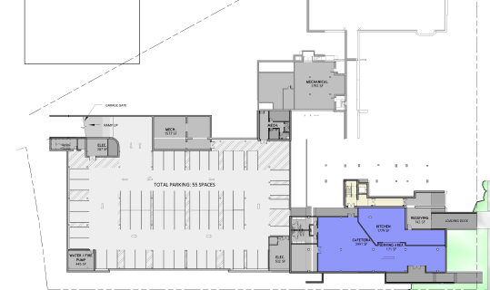
Murch Building Update: Estimate
DCPS | OCOO
Project Budget: $68 Million
MCN Build provided a cost estimate to DGS and DCPS. The building estimates are coming in around $10 million over budget.
Funding for swing space will be included in a budget enhancement.
MCN identified the underground parking and current design of the cafeteria as the biggest cost drivers for the project.

Slide 7
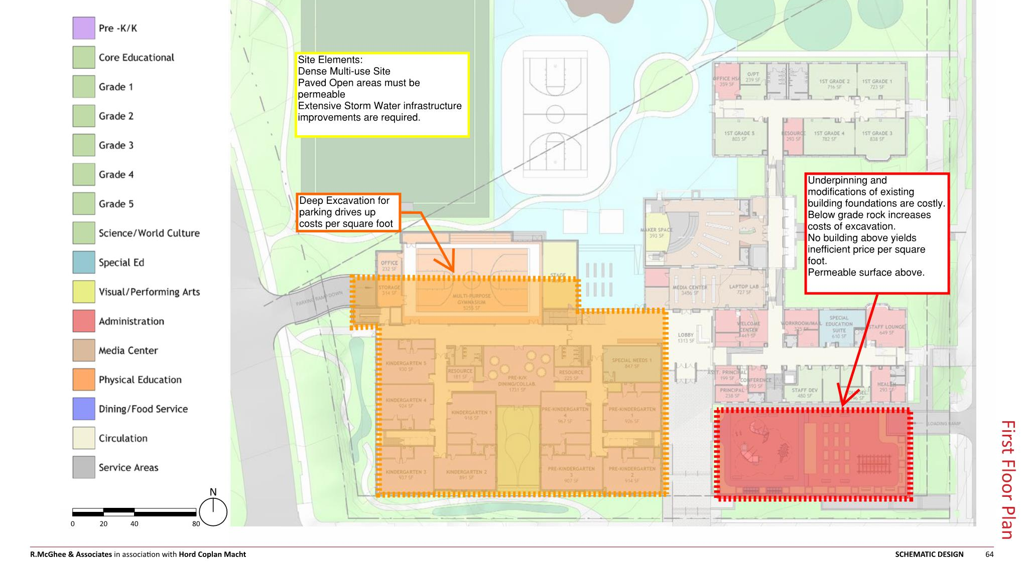
Murch Building Update: Estimate
DCPS | OCOO

Slide 8
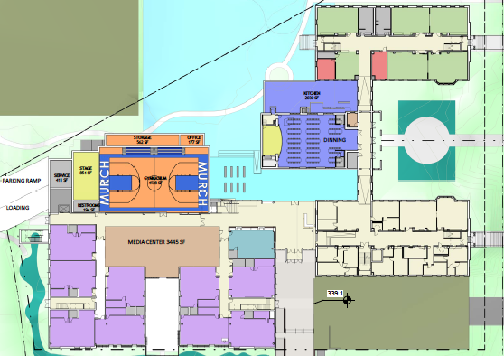
Design Updates Scenario 1: Program Movement
DCPS | OCOO
Observations
Provides separate gym, cafeteria, and library spaces.
Does not provide direct access to the kitchen, which makes delivery a challenge.
Removes the PK/K commons space.
Slight reduction in media center size.

Slide 9
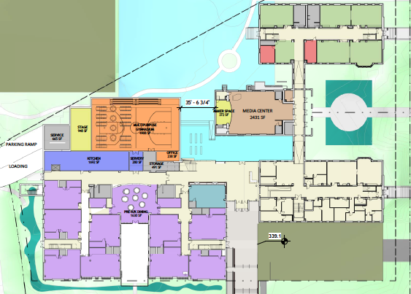
Design Updates Scenario 2: Program Movement
DCPS | OCOO
Observations
Kitchen has direct access to loading area.
Maintains PK/K commons area.
Having a combined cafeteria & gym area could be an operational challenge.
Reduction in media center size.

Slide 10
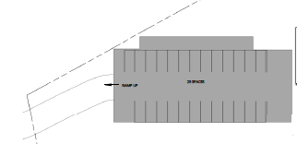
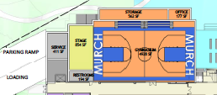
Parking Evaluation
DCPS | OCOO
Three options are being explored:
~25 surface parking at the corner of Davenport and 36th St. Would require a change in the PK/K play location.
50% reduction in the number of underground spaces below the gym. Entrance off Reno. This option would require additional “Value Engineering” in the building.
Raise the gym ~ 8ft and having parking at grade under the gym.
Note: We may be able to combine option 1 with options 2 or 3 to get the ~50 spaces originally design
36th
Davenport
Reno
Reno

Slide 11
Murch Building Schedule
DCPS | OCOO
PROPOSED SWING SPACE SCHEDULE
Design Revisions: Late February/Early March
Completion of First Design Permit Package: Late April
Receipt of First Permit (Excavation & Site work): Late June
Mobilization: Late June

Slide 12
Next Steps
DCPS | OCOO
UDC work session with DCPS, UDC, Murch Leadership, SIT (2 members), and Field LLC. Date TBD.
Next SIT Meeting: February 24^{th @} 6PM
Topics:
Continued review of Murch building design
Update on UDC Discussion
Review of UDC Trailer Layout

