Slide 1
Ron Brown Modernization
April 14, 2016 7PM
Notes:
Toussaint’s Slide:
Thank you Commissioner Holmes for allowing us some time to present on the Ron Brown College Preparatory High School at the Ron Brown building in Deanwood.

Slide 2
Project Overview Ward 7/Deanwood Business and Workforce Participation Updates Exterior Site Improvements Review of Construction Schedule Afterhours Work
Agenda
Notes:
Toussaint’s Slide:
We have 5 minutes to cover all of the agenda items. So we’re going jump right in and tell you why we’re here. We’re requesting 2 letters of support:
1 for zoning for parking and site improvements
A second one for an afterhours works permit
So we’re going to start with a quick overview of the project
Then we’ll cover our efforts to ensure that Ward 7 businesses and workers are given an opportunity to work on this project
Then we will present the site improvements and parking we need your zoning approval for
Next we will go over the construction schedule and need for an afterhours work permit
Then we’ll be out of your way

Slide 3
Location: 4800 Meade St NE, Washington, DC (Ron Brown Building) Ward: 7 DGS Project Manager: Mia Sensabaugh DCPS Facilities Team: Patrick Davis & Toussaint Webster Architect: Perkins Eastman DC General Contractor: Gilbane Building Co. Project Completion Date: Phase 1 -- August 8, 2016; Phase 2 -- August 2017 Project Status: Design Development (Documents)
Project Overview
Program Overview: 600 student city-wide college prep high school for males
Notes:
Toussaint’s Slide:
Here are some facts about the project that will be taking place in the old Ron Brown building right behind the Deanwood Rec Center. This Ron Brown College Preparatory High School was a part of Mayor Bowser’s initiative on Males of Color. This will be a city-wide college prep high school for males that focuses on business and leadership using technology.
It’s right here in Ward 7, but young men from all over DC can join
The DC Department of General Services Project Manager is Mia Sensabaugh
The Architect is Perkins Eastman DC
The General Contractor is Gilbane Building Company
Currently, the project is in the Design Development stage. This phase lays out mechanical, electrical, plumbing, structural, and architectural details. The architect moves forward and produces drawings with great detail.
Overall Project Budget: $40M (construction costs) = [Phase 1 = $32M] + [Phase 2 = $8M]
What schools compare with this?
$40M is lower than the other high schools, but it will be serving half as many students
(get the #s for Anacostia $63M, Ballou, and Woodson)

Slide 4
Local Workforce Outreach & Engagement
Contractors Onsite
Goel Services (Demo & Abatement) – Onsite Workforce (to-date)
DC Residents 54 employees
Ward 7 Residents 15 employees
Deanwood Residents 7 employees
Deanwood Workforce Interviews
April 5th, 7th, and 14th 2016 (40 interviews)
Contractors Bidding the Job
Gilbane has identified 7 positions for Deanwood residents that can be moved onto the project in the next 30 days as part of a subcontract
Bidding Contractors are screening available Ward 7 and Deanwood residents
Deanwood Resident Workforce plan will be issued by the Trades upon award.
Notes:
Jackie’s Slide:
We understand that all construction projects can potentially inconvenience the people who live near the school. So we are working with ANC7C and the Community to proactively mitigate as much of the headaches as we can. Construction is a nuisance, but we want to control as much of that as possible.
(Don’t Mention, unless specifically asked: The plan is to have items such as chipping, jackhammering, and slab cutting to occur between the hours of 7am – 7pm. Outside of those hours we will limit the work to items such as piping removal, ceiling removal, floor tile removal, etc. Items that will not create loud reverberating noises. )
Is there a place that residents can call to complain about noise or to express concern? Will traffic be obstructed at any point with trucks parked/idling/workers, etc.?
Complaints should be forwarded to DGS. Traffic should not be obstructed for deliveries. Our plan is to have vehicles in the parking lot. When we perform utility work in the street there will be lane closures per DDOT requirements.

Slide 5
Local Business Outreach & Engagement
Deanwood Business Interviews
April 11th and 12th
Two additional sessions planned – April 18th and April 19th
21 businesses have been contacted
11 businesses have been interviewed
Contractors Bidding the Job
Bidding Contractors are screening available Ward 7 and Deanwood businesses
Consideration is being given at all levels – prime contracts, subcontracts and suppliers on the project.
Notes:
Jackie’s Slide:
We understand that all construction projects can potentially inconvenience the people who live near the school. So we are working with ANC7C and the Community to proactively mitigate as much of the headaches as we can. Construction is a nuisance, but we want to control as much of that as possible.
(Don’t Mention, unless specifically asked: The plan is to have items such as chipping, jackhammering, and slab cutting to occur between the hours of 7am – 7pm. Outside of those hours we will limit the work to items such as piping removal, ceiling removal, floor tile removal, etc. Items that will not create loud reverberating noises. )
Is there a place that residents can call to complain about noise or to express concern? Will traffic be obstructed at any point with trucks parked/idling/workers, etc.?
Complaints should be forwarded to DGS. Traffic should not be obstructed for deliveries. Our plan is to have vehicles in the parking lot. When we perform utility work in the street there will be lane closures per DDOT requirements.

Slide 6
Local Services Needed
Project Site – Referrals from Deanwood Community:
Catering/Restaurants – Jobsite Events
Pest Control Services
Bottled Water Service
More services are being identified
Send all Inquiries:
Ron Brown High School Project (Linda Graves)
BuildingDC@Gilbaneco.com
(202) 230-7278
Notes:
Mia’s Slide:
We understand that all construction projects can potentially inconvenience the people who live near the school. So we are working with ANC7C and the Community to proactively mitigate as much of the headaches as we can. Construction is a nuisance, but we want to control as much of that as possible.
(Don’t Mention, unless specifically asked: The plan is to have items such as chipping, jackhammering, and slab cutting to occur between the hours of 7am – 7pm. Outside of those hours we will limit the work to items such as piping removal, ceiling removal, floor tile removal, etc. Items that will not create loud reverberating noises. )
Is there a place that residents can call to complain about noise or to express concern? Will traffic be obstructed at any point with trucks parked/idling/workers, etc.?
Complaints should be forwarded to DGS. Traffic should not be obstructed for deliveries. Our plan is to have vehicles in the parking lot. When we perform utility work in the street there will be lane closures per DDOT requirements.

Slide 7
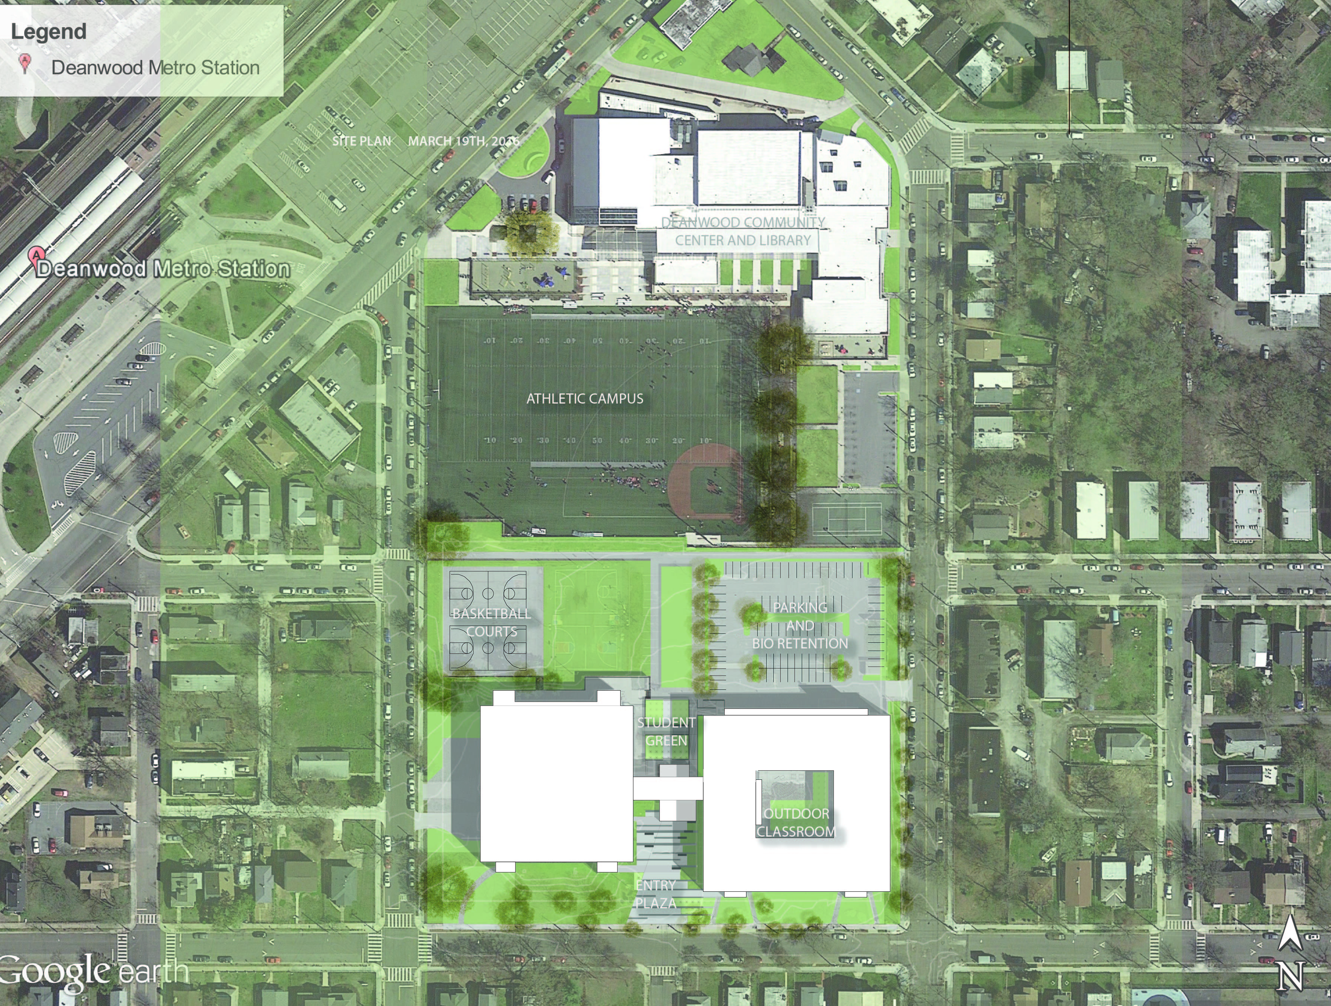
CAMPUS PLAN
Notes:
Abbie

Slide 8
SITE IMPROVEMENTS
PEDESTRIAN CONNECTOR MAINTAINED
NEW
COURTS
STUDENT GREEN
ENTRY PLAZA
Notes:
Abbie:

Slide 9
PARKING AND LOADING
STAFF PARKING
STAFF: +/- 100
SPACES:
83 EXISTING
85 PROPOSED
MODAL SPLIT
60% METRO/BUS
35% VIA CAR
5% BIKE/WALK
DELIVERIES
KITCHEN
LOADING
Notes:
Abbie:

Slide 10
Phase I Construction Schedule
March 2016 – interior demolition and abatement begins in late March
April 2016 – interior demolition and abatement continues through late April; exterior demolition begins in mid-April
May 2016 – exterior demolition continues through end of May
June 2016 – construction
July 2016 – construction
August 2016 – Phase 1/first floor construction complete
Notes:
Mia’s Slide:
By the end of this month, demolition inside of the building will begin
It will continue through late April and add some demolition to the outside of the building.
All demolition will be done by the end of May.
For the rest of the summer, Phase 1 construction (i.e. the first floor) will occur at an aggressive pace.
Out goal is to have the first floor done for the 9th Grade Academy to move in by Monday August 8, 2016
Following that, Phase 2 construction will continue throughout the year for a full building completion in August 2017.

Slide 11
Afterhours Work
Proposed Extended Work Hours:
Monday-Friday 6am to 9pm
Saturday 6am to 9pm
Sunday 7am to 3pm
The community can contact toussaint.webster@dc.gov or 202-794-3549 with questions
Notes:
Mia’s Slide:
We understand that all construction projects can potentially inconvenience the people who live near the school. So we are working with ANC7C and the Community to proactively mitigate as much of the headaches as we can. Construction is a nuisance, but we want to control as much of that as possible.
(Don’t Mention, unless specifically asked: The plan is to have items such as chipping, jackhammering, and slab cutting to occur between the hours of 7am – 7pm. Outside of those hours we will limit the work to items such as piping removal, ceiling removal, floor tile removal, etc. Items that will not create loud reverberating noises. )
Is there a place that residents can call to complain about noise or to express concern? Will traffic be obstructed at any point with trucks parked/idling/workers, etc.?
Complaints should be forwarded to DGS. Traffic should not be obstructed for deliveries. Our plan is to have vehicles in the parking lot. When we perform utility work in the street there will be lane closures per DDOT requirements.

Slide 12
Construction Hours Breakdown (Mondays – Fridays)
 | Interior Light Demolition | Interior Light Construction | Interior Finishes |  | Interior Interim Clean-Up
5am-7am (Mon-Fri) QUIET WORK | Ceiling removal | Framing | Ceiling Installation
 | Loose equipment removal | Drywall | Flooring installation
 | Loose furniture and fixture removal | Masonry | Painting
 | Drywall removal | Pipe installation | Finish Carpentry & Millwork installation
 |  | Duct installation | Fixture/Device Installation
 |  | Wire Installation
 | QUIET WORK - QUIET WORK - QUIET WORK - QUIET WORK - QUIET WORK - QUIET WORK - QUIET WORK
 | Interior Demolition | Interior Construction
7am-7pm (Mon-Fri) | Chipping | Chipping
 | Drilling | Drilling
 | Grinding | Grinding
 | Cutting | Cutting
Notes:
Mia’s Slide:
We understand that all construction projects can potentially inconvenience the people who live near the school. So we are working with ANC7C and the Community to proactively mitigate as much of the headaches as we can. Construction is a nuisance, but we want to control as much of that as possible.
(Don’t Mention, unless specifically asked: The plan is to have items such as chipping, jackhammering, and slab cutting to occur between the hours of 7am – 7pm. Outside of those hours we will limit the work to items such as piping removal, ceiling removal, floor tile removal, etc. Items that will not create loud reverberating noises. )
Is there a place that residents can call to complain about noise or to express concern? Will traffic be obstructed at any point with trucks parked/idling/workers, etc.?
Complaints should be forwarded to DGS. Traffic should not be obstructed for deliveries. Our plan is to have vehicles in the parking lot. When we perform utility work in the street there will be lane closures per DDOT requirements.

Slide 13
Construction Hours Breakdown (Mondays – Fridays)
 | Interior Light Demolition | Interior Light Construction | Interior Finishes | Interior Interim Clean-Up
7pm-10pm (Mon-Fri) | Ceiling removal | Framing | Ceiling Installation
 | Loose equipment removal | Drywall | Flooring installation
 | Loose furniture and fixture removal | Masonry | Painting
 | Drywall removal | Pipe installation | Finish Carpentry & Millwork Installation
 |  | Duct installation | Fixture/Device Installation
 |  | Wire Installation
 | QUIET WORK - QUIET WORK - QUIET WORK - QUIET WORK - QUIET WORK - QUIET WORK - QUIET WORK
Notes:
Mia’s Slide:
We understand that all construction projects can potentially inconvenience the people who live near the school. So we are working with ANC7C and the Community to proactively mitigate as much of the headaches as we can. Construction is a nuisance, but we want to control as much of that as possible.
(Don’t Mention, unless specifically asked: The plan is to have items such as chipping, jackhammering, and slab cutting to occur between the hours of 7am – 7pm. Outside of those hours we will limit the work to items such as piping removal, ceiling removal, floor tile removal, etc. Items that will not create loud reverberating noises. )
Is there a place that residents can call to complain about noise or to express concern? Will traffic be obstructed at any point with trucks parked/idling/workers, etc.?
Complaints should be forwarded to DGS. Traffic should not be obstructed for deliveries. Our plan is to have vehicles in the parking lot. When we perform utility work in the street there will be lane closures per DDOT requirements.

Slide 14
Construction Hours Breakdown (Saturdays)
 | Interior Light Demolition | Interior Light Construction | Interior Finishes | Interior Interim Clean-Up
6am-7am (Sat ONLY) QUIET WORK | Ceiling removal | Framing | Ceiling Installation
 | Loose equipment removal | Drywall | Flooring installation
 | Loose furniture and fixture removal | Masonry | Painting
 | Drywall removal | Pipe installation | Finish Carpentry & Millwork installation
 |  | Duct installation | Fixture/Device Installation
 |  | Wire Installation
 | QUIET WORK - QUIET WORK - QUIET WORK - QUIET WORK - QUIET WORK - QUIET WORK - QUIET WORK
 | Interior Demolition | Interior Construction
7am-7pm (Sat ONLY) | Chipping | Chipping
 | Drilling | Drilling
 | Grinding | Grinding
 | Cutting | Cutting
Notes:
Mia’s Slide:
We understand that all construction projects can potentially inconvenience the people who live near the school. So we are working with ANC7C and the Community to proactively mitigate as much of the headaches as we can. Construction is a nuisance, but we want to control as much of that as possible.
(Don’t Mention, unless specifically asked: The plan is to have items such as chipping, jackhammering, and slab cutting to occur between the hours of 7am – 7pm. Outside of those hours we will limit the work to items such as piping removal, ceiling removal, floor tile removal, etc. Items that will not create loud reverberating noises. )
Is there a place that residents can call to complain about noise or to express concern? Will traffic be obstructed at any point with trucks parked/idling/workers, etc.?
Complaints should be forwarded to DGS. Traffic should not be obstructed for deliveries. Our plan is to have vehicles in the parking lot. When we perform utility work in the street there will be lane closures per DDOT requirements.

Slide 15
Construction Hours Breakdown (Sundays)
 | Interior Light Demolition | Interior Light Construction | Interior Finishes | Interior Interim Clean-Up
8am-4pm (Sun ONLY) QUIET WORK | Ceiling removal | Framing | Ceiling Installation
 | Loose equipment removal | Drywall | Flooring installation
 | Loose furniture and fixture removal | Masonry | Painting
 | Drywall removal | Pipe installation | Finish Carpentry & Millwork installation
 |  | Duct installation | Fixture/Device Installation
 |  | Wire Installation
 | QUIET WORK - QUIET WORK - QUIET WORK - QUIET WORK - QUIET WORK - QUIET WORK - QUIET WORK
Notes:
Mia’s Slide:
We understand that all construction projects can potentially inconvenience the people who live near the school. So we are working with ANC7C and the Community to proactively mitigate as much of the headaches as we can. Construction is a nuisance, but we want to control as much of that as possible.
(Don’t Mention, unless specifically asked: The plan is to have items such as chipping, jackhammering, and slab cutting to occur between the hours of 7am – 7pm. Outside of those hours we will limit the work to items such as piping removal, ceiling removal, floor tile removal, etc. Items that will not create loud reverberating noises. )
Is there a place that residents can call to complain about noise or to express concern? Will traffic be obstructed at any point with trucks parked/idling/workers, etc.?
Complaints should be forwarded to DGS. Traffic should not be obstructed for deliveries. Our plan is to have vehicles in the parking lot. When we perform utility work in the street there will be lane closures per DDOT requirements.

Slide 16
We Appreciate Your Support DCPS Contact: toussaint.webster@dc.gov
Notes:
Mia’s Slide:
End this asking for a:
Vote for afterhours letter of support
Vote for a letter in support of maintaining parking count despite the size of the auditorium and the zoning implications

