Slide 1
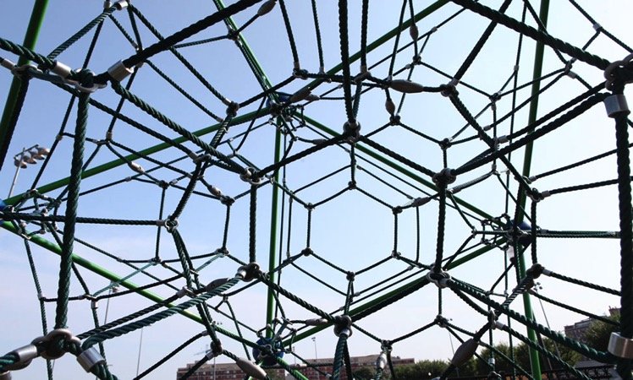
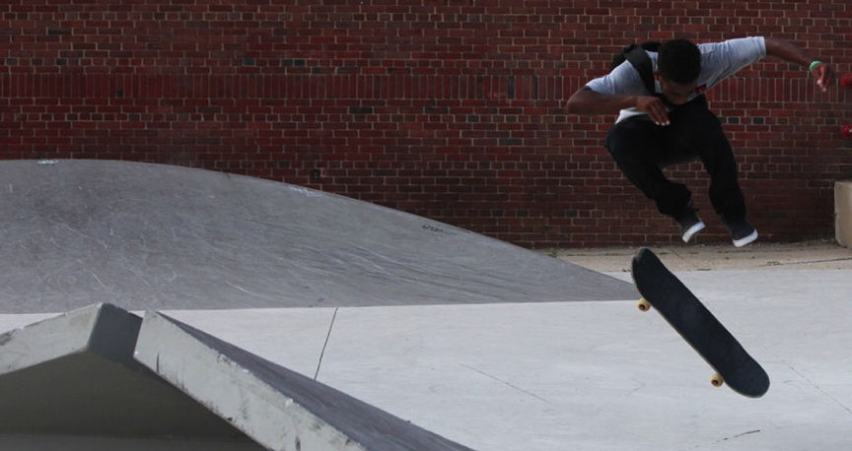
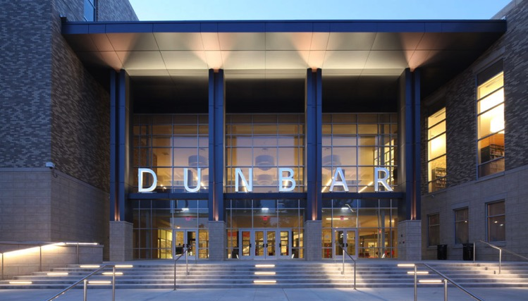
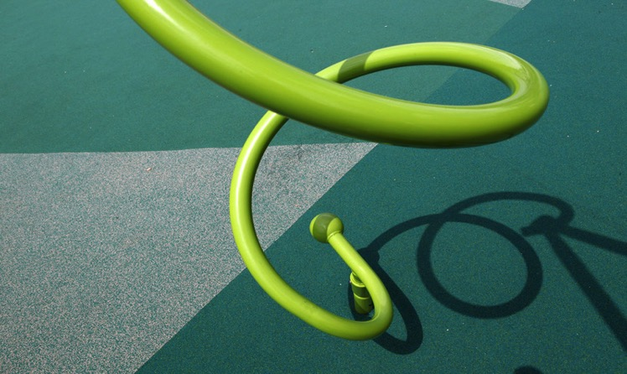
Elevating the Quality of Life in the District

Slide 2
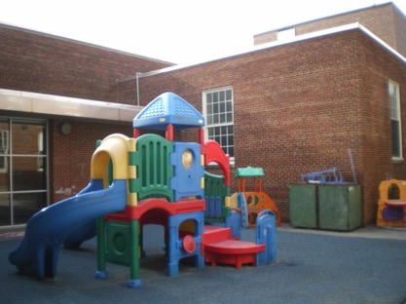
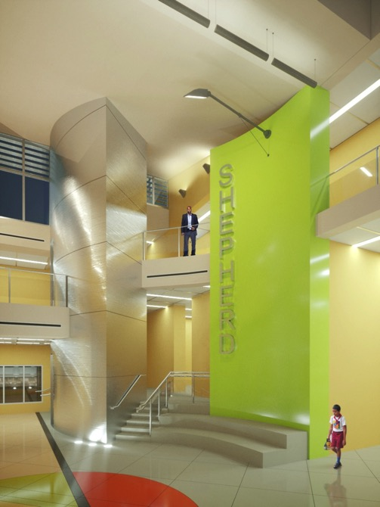
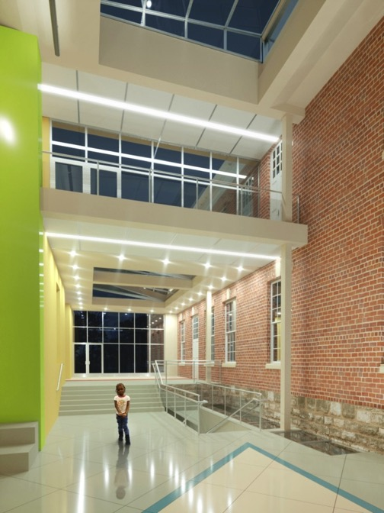
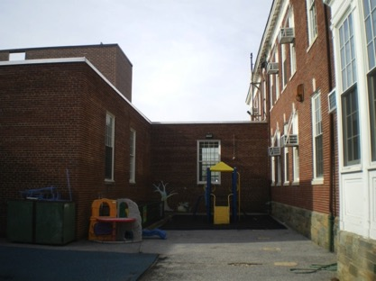
Elevating the Quality of Life in the District
Elevating the Quality of Life in the District
BEFORE RENOVATION
BEFORE RENOVATION
AFTER RENOVATION
AFTER RENOVATION
COURTYARD

Slide 3
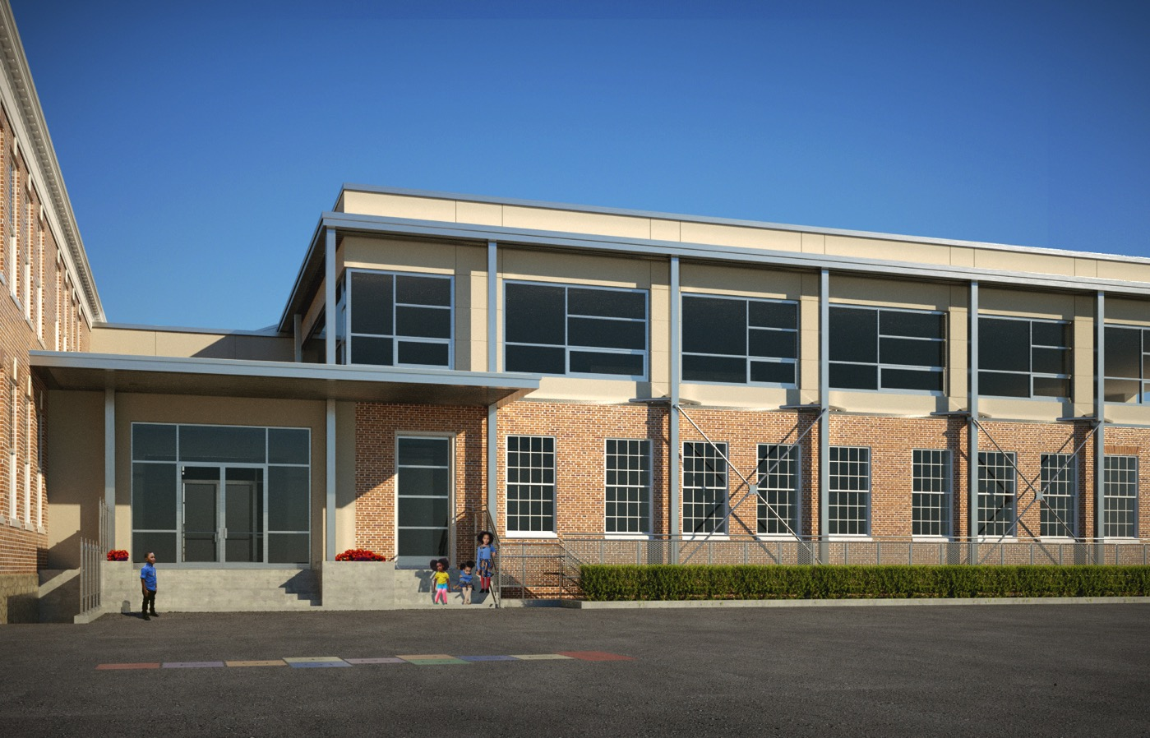
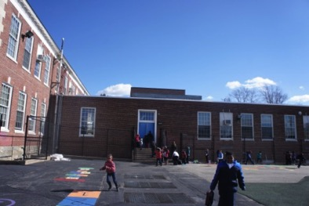
Elevating the Quality of Life in the District
BEFORE RENOVATION
AFTER RENOVATION
REAR ELEVATION

Slide 4
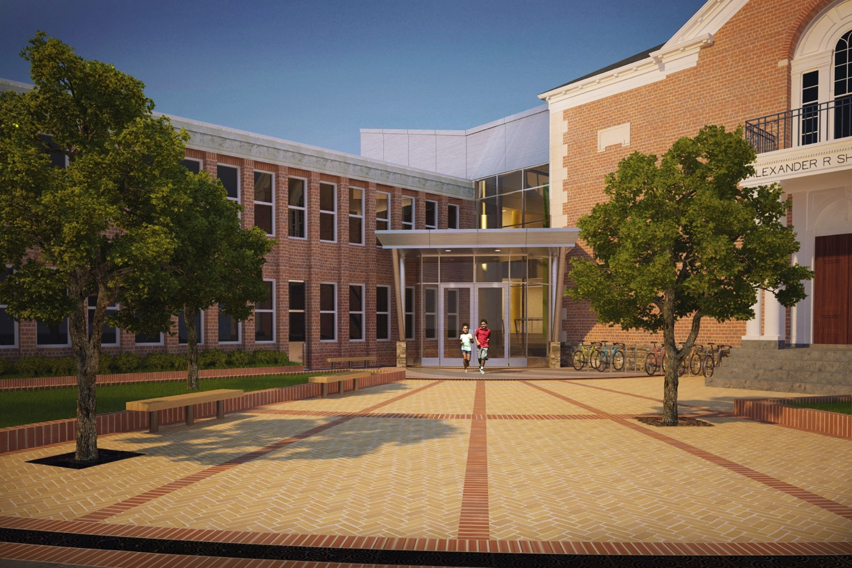
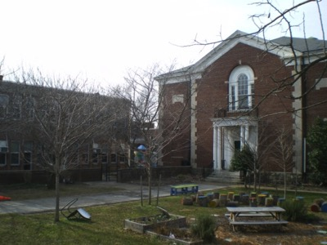
Elevating the Quality of Life in the District
BEFORE RENOVATION
AFTER RENOVATION
MAIN ENTRANCE

Slide 5
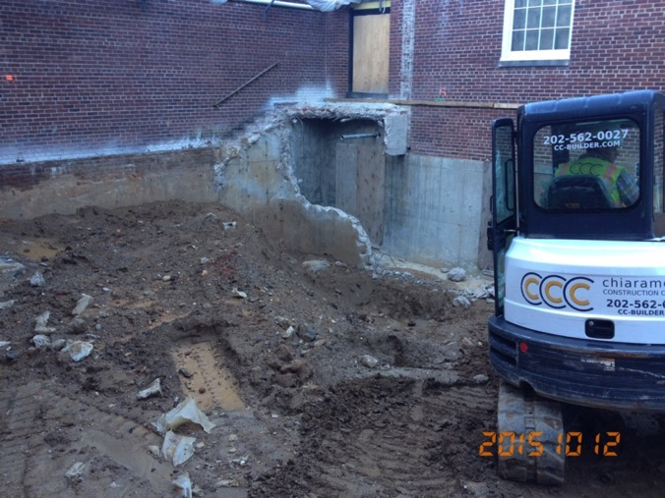
Excavation & Demo in Courtyard

Slide 6
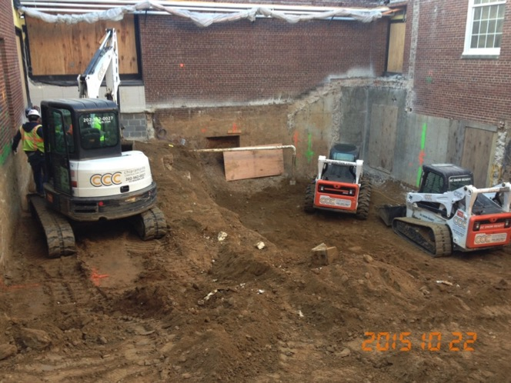
Excavation & Demo in Courtyard

Slide 7
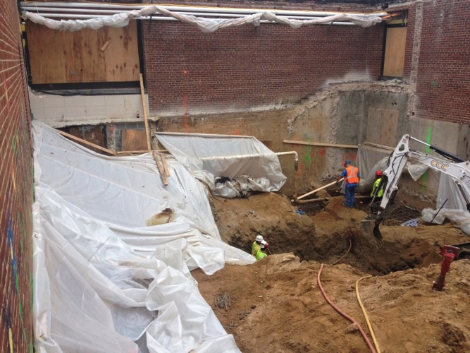
Excavation & Demo in Courtyard

Slide 8
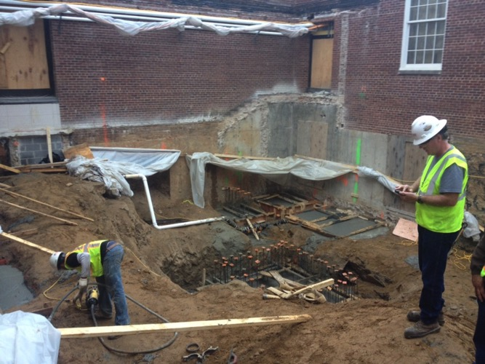
Installation of Foundation System & Elevator Pit in Courtyard

Slide 9
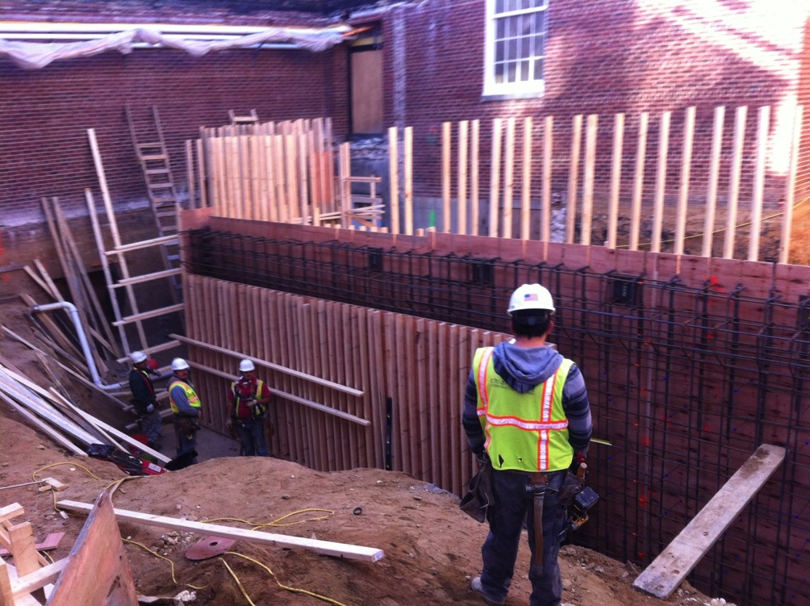
Courtyard Retaining Wall Installation

Slide 10
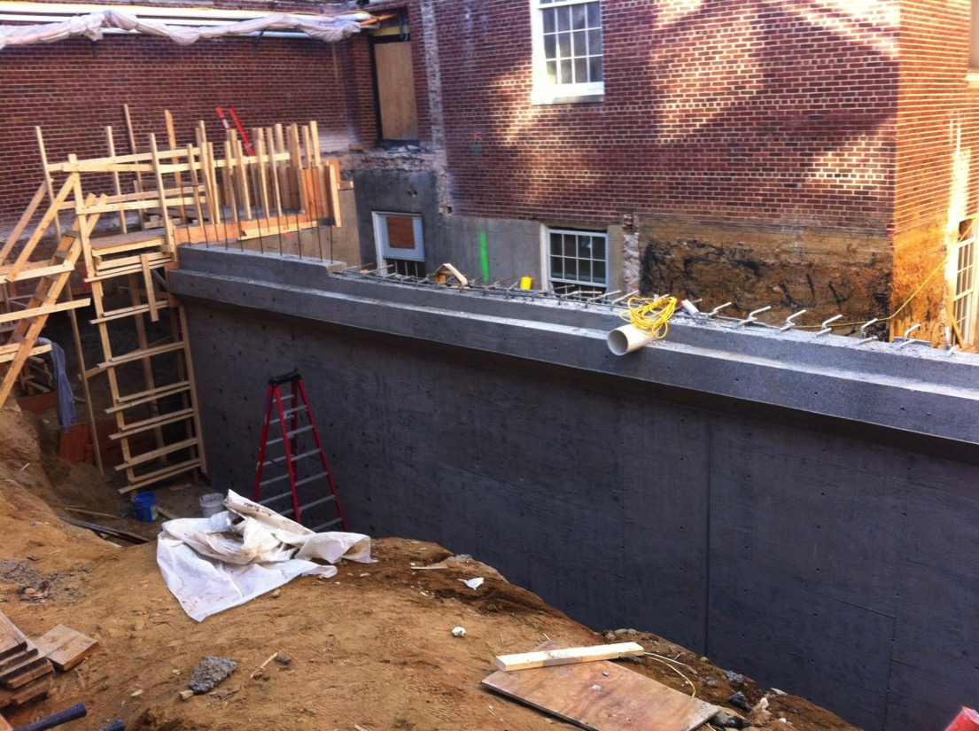
Courtyard Retaining Wall Installation

Slide 11
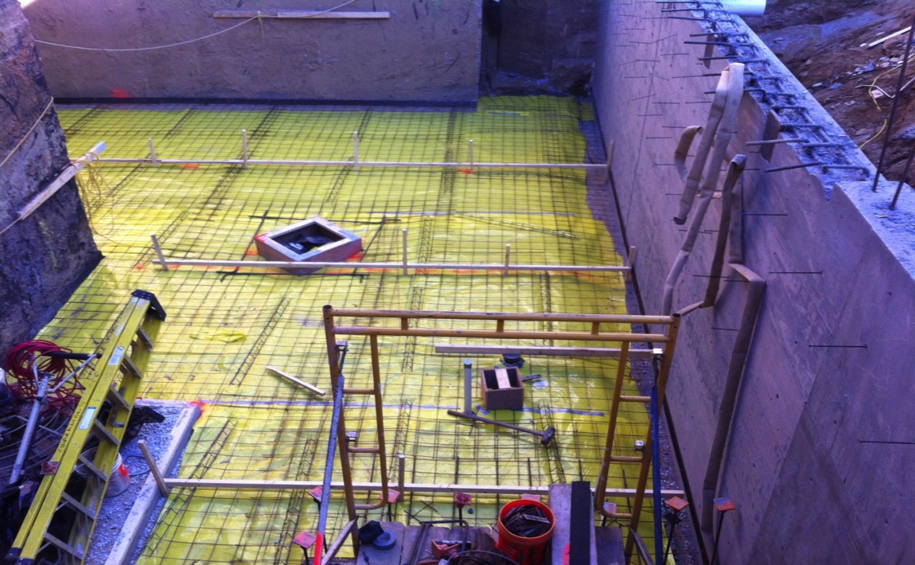
Courtyard Concrete Slab Installation

Slide 12
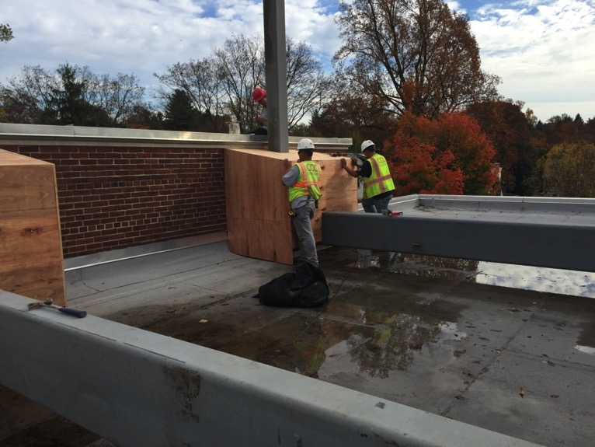
Erection of Structural Steel in Cafeteria & Roof of 1956 Building

Slide 13
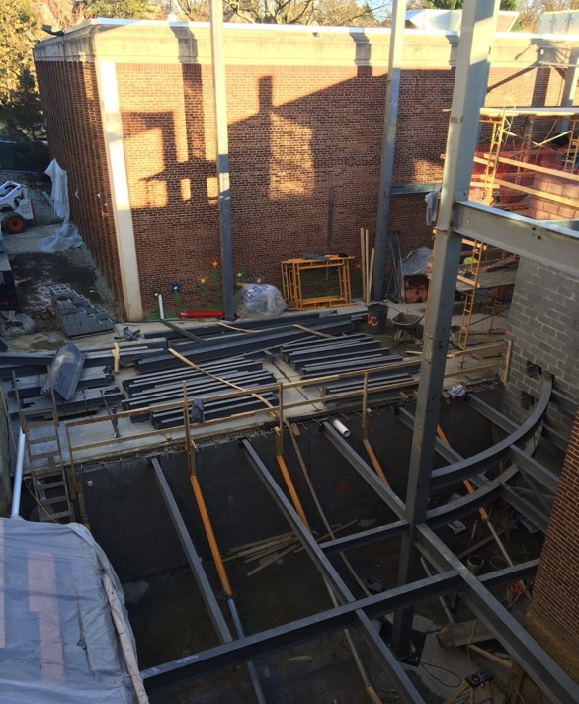
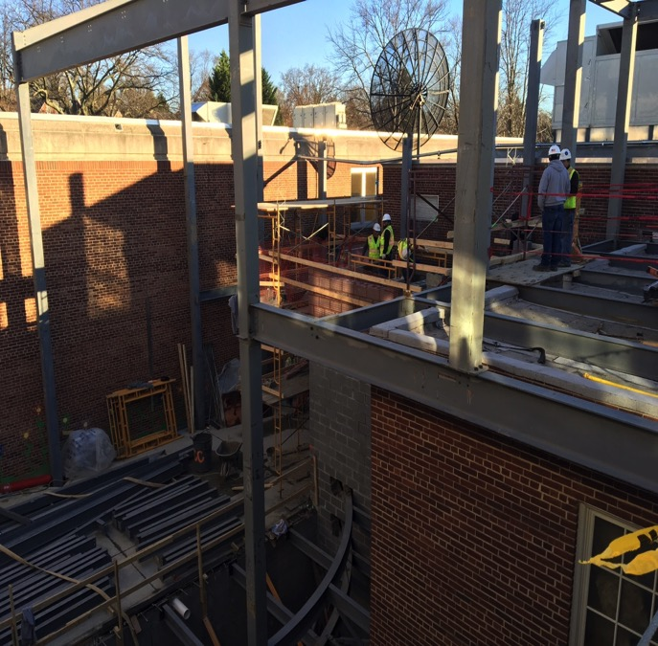
Courtyard Concrete Slab Retaining Wall & Elevator Shaft Installation

Slide 14
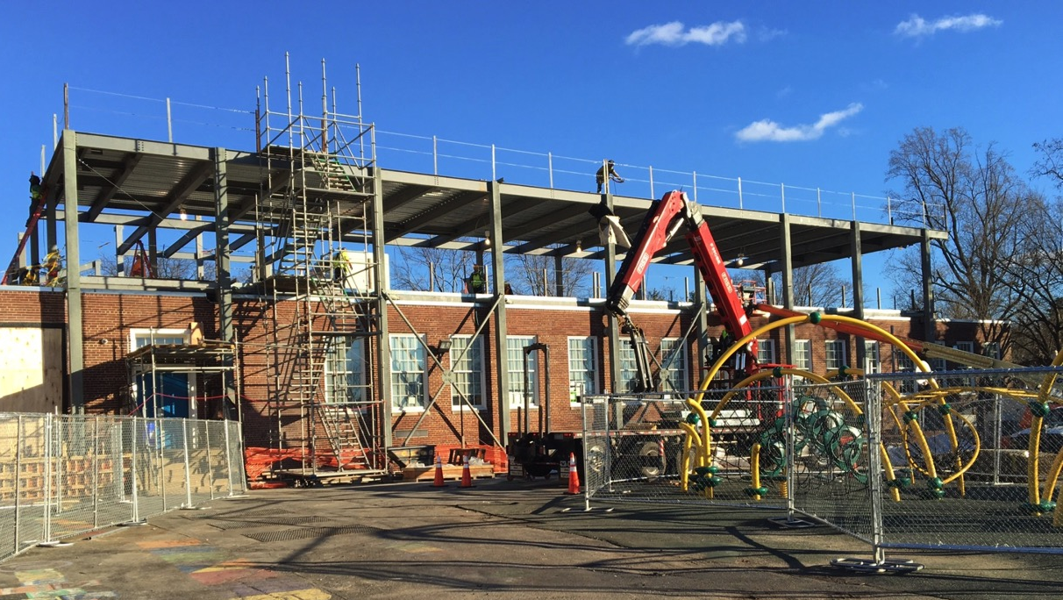
1956 Building Addition Structural Steel Installation

Slide 15
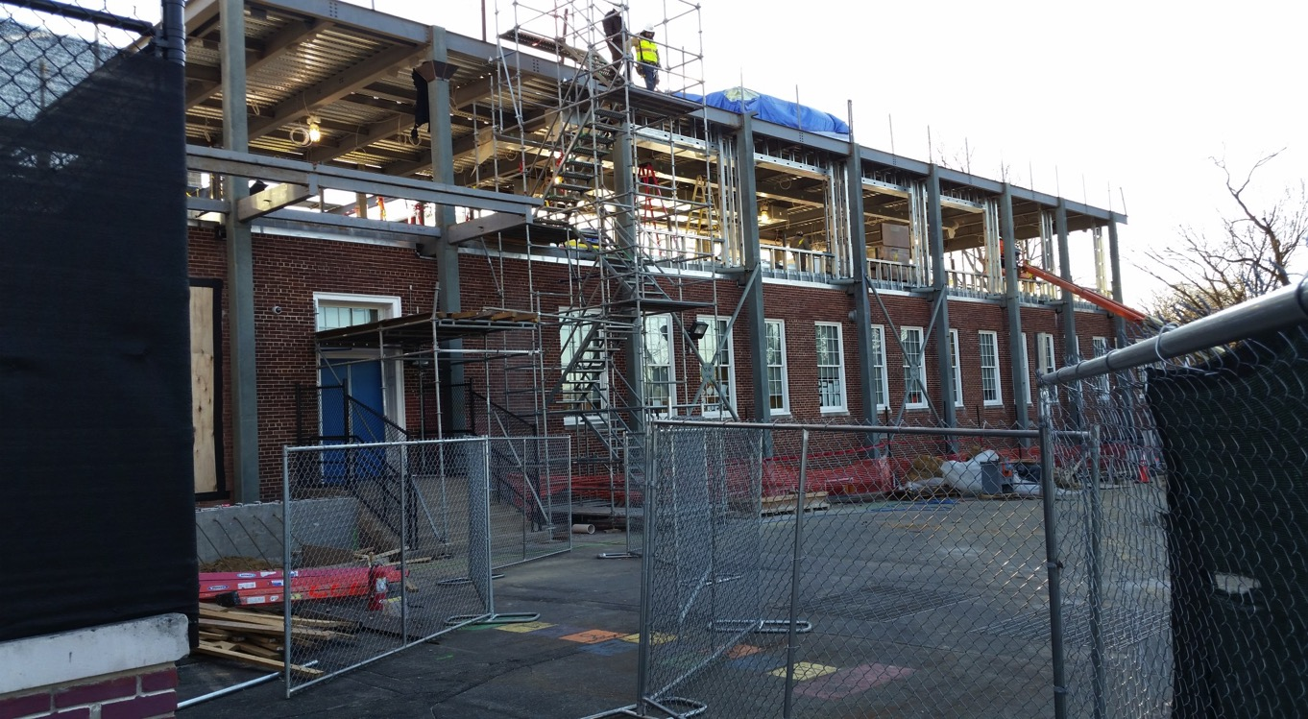
1956 Building Addition Structural Steel, Framing Installation

Slide 16
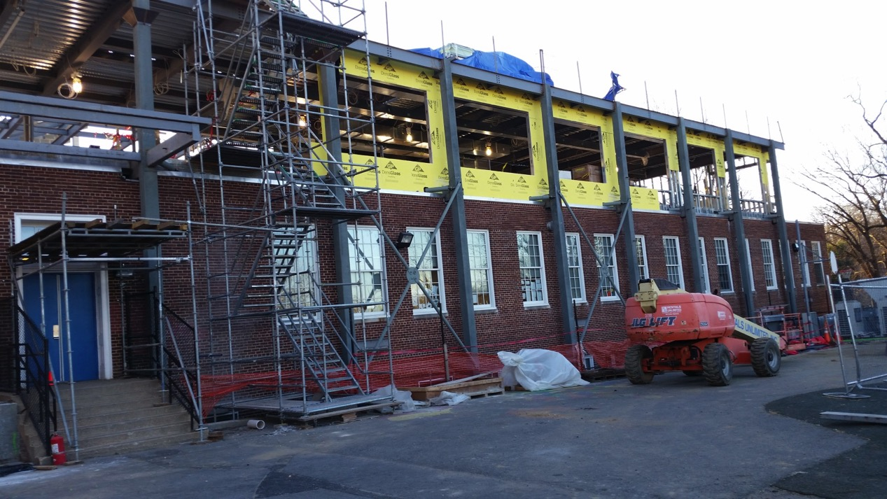
1956 Building Addition Structural Steel, Framing Installation

Slide 17
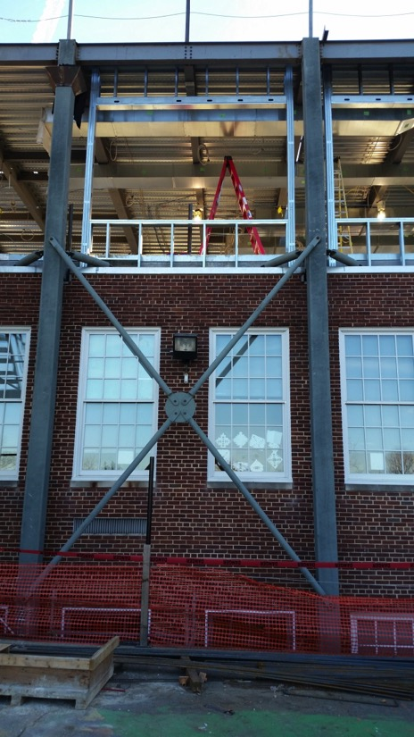
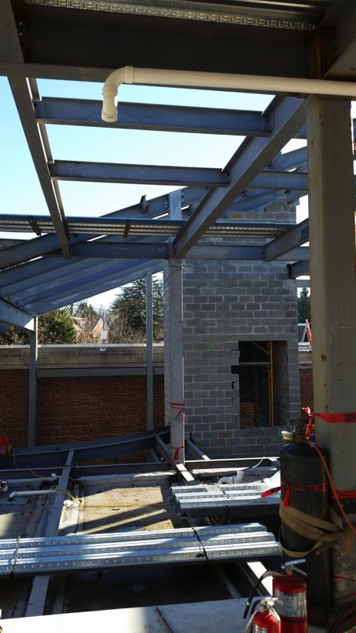
1956 Building Addition Structural Steel Installation

Slide 18
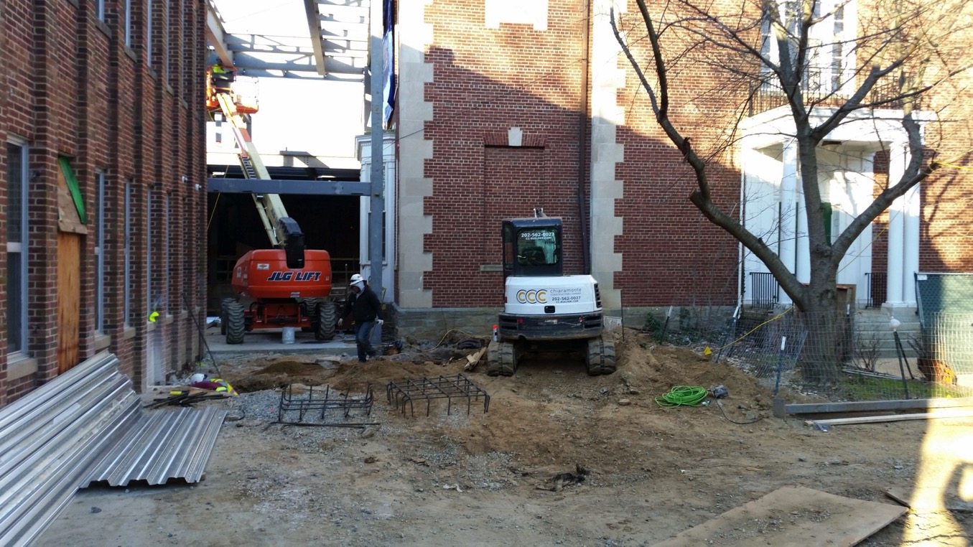
Entrance Structural Steel Installation

Slide 19
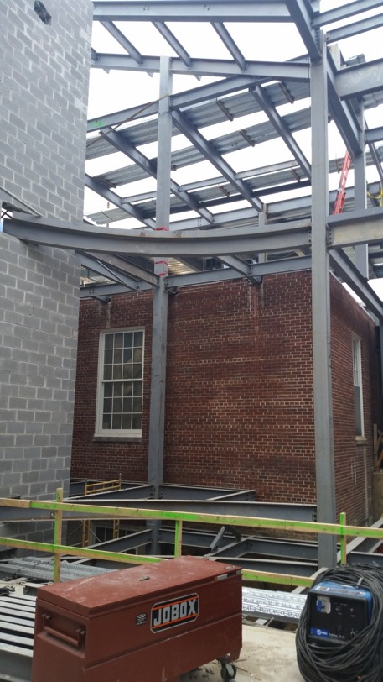
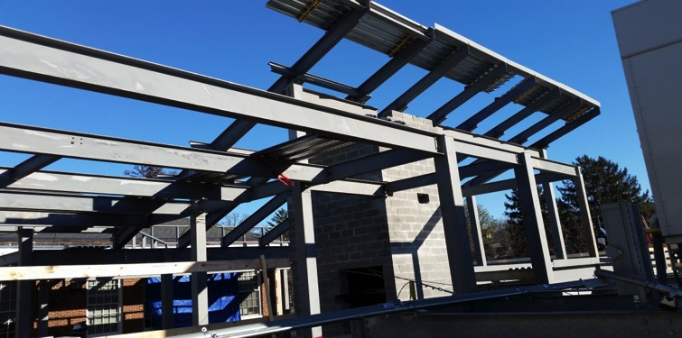
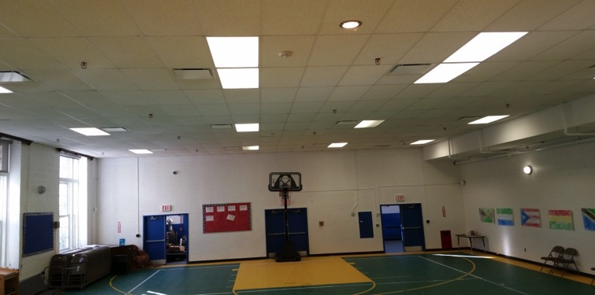
Courtyard Structural Steel & Sprinkler Installation

Slide 20
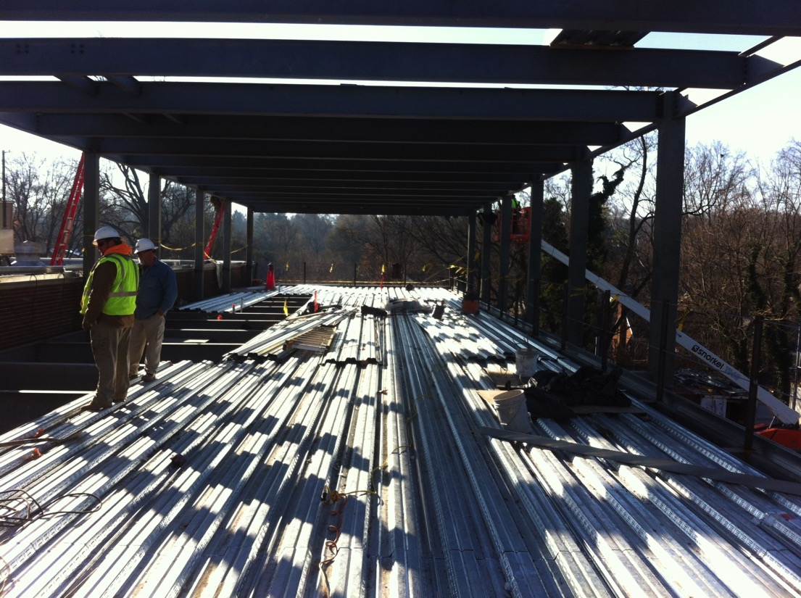
1956 Building Addition Metal Deck Installation

Slide 21
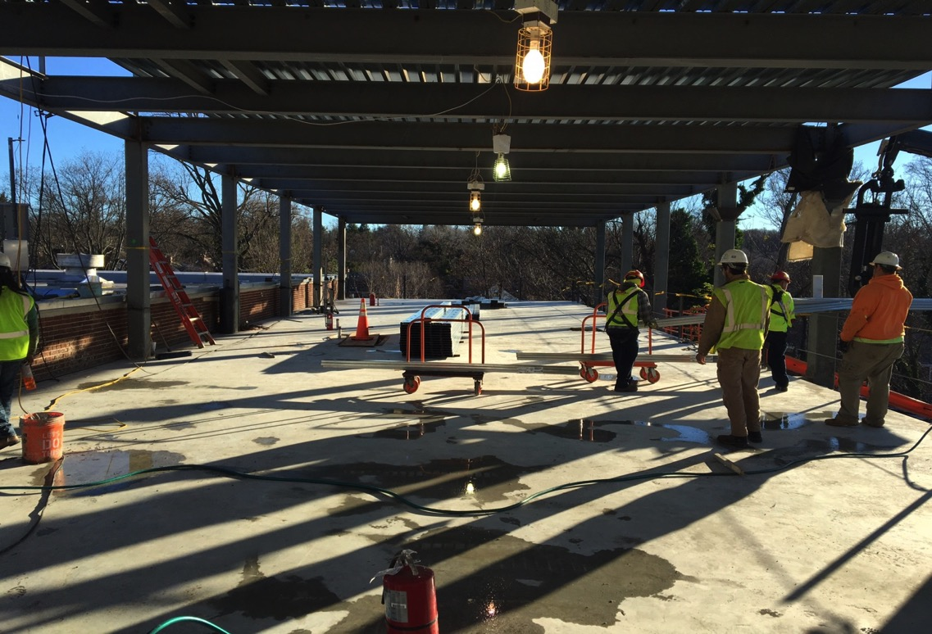
1956 Building Addition Concrete Slab Installation

Slide 22
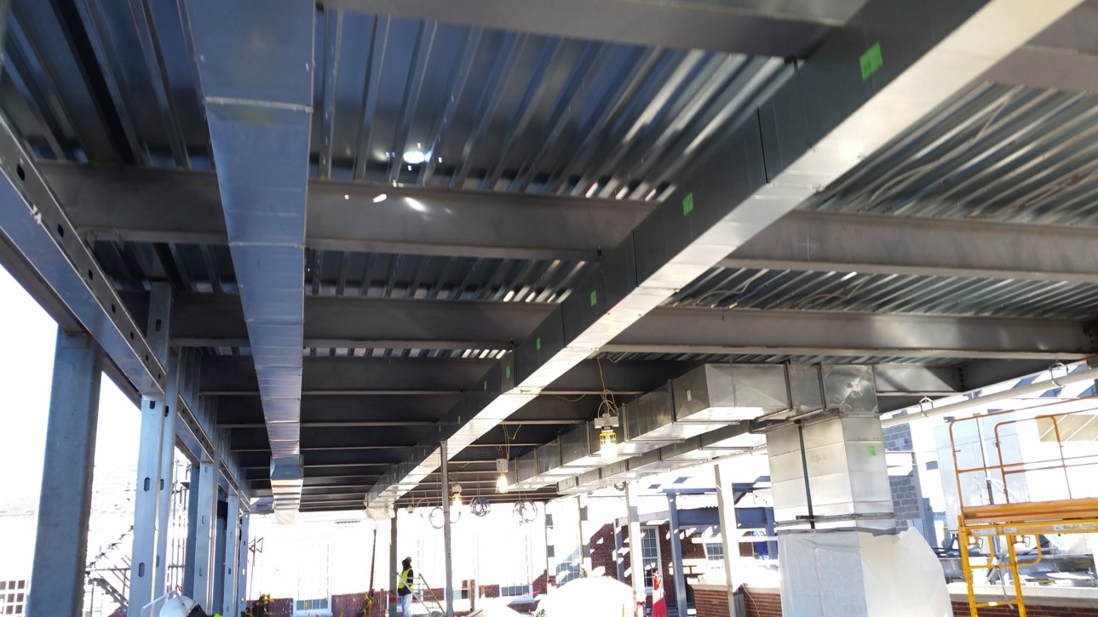
1956 Building Addition MEP Installation

Slide 23
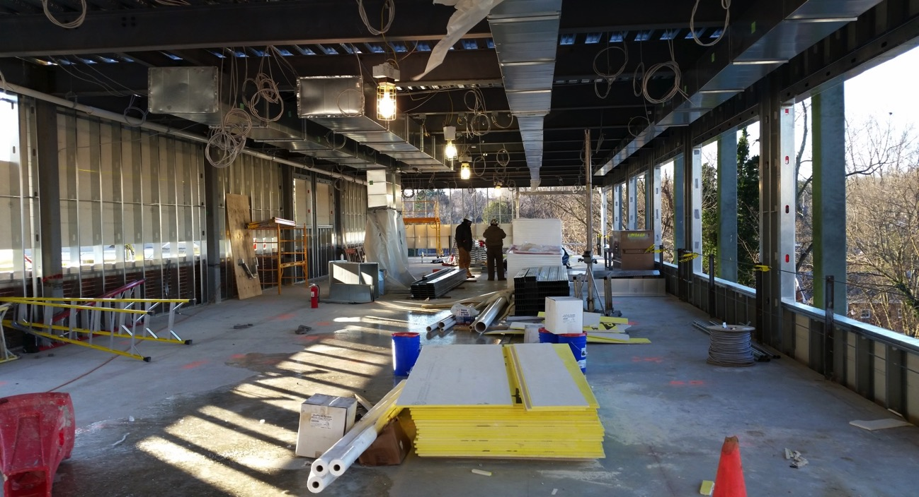
1956 Building Addition Structural Steel Framing and MEP Installation

Slide 24
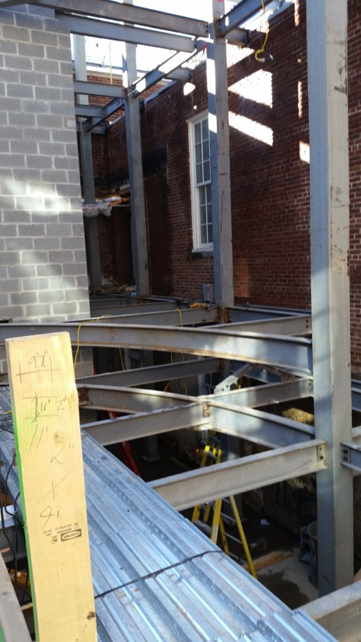
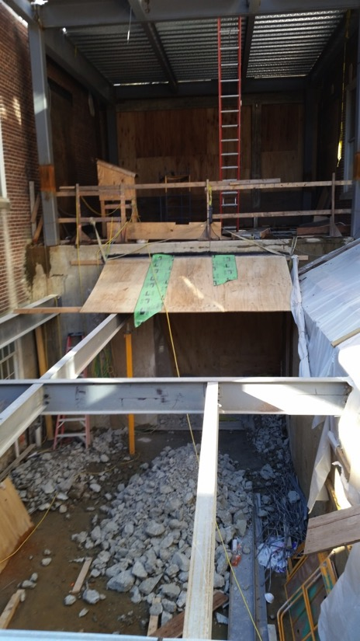
Courtyard Steel and Opening Installation

Slide 25
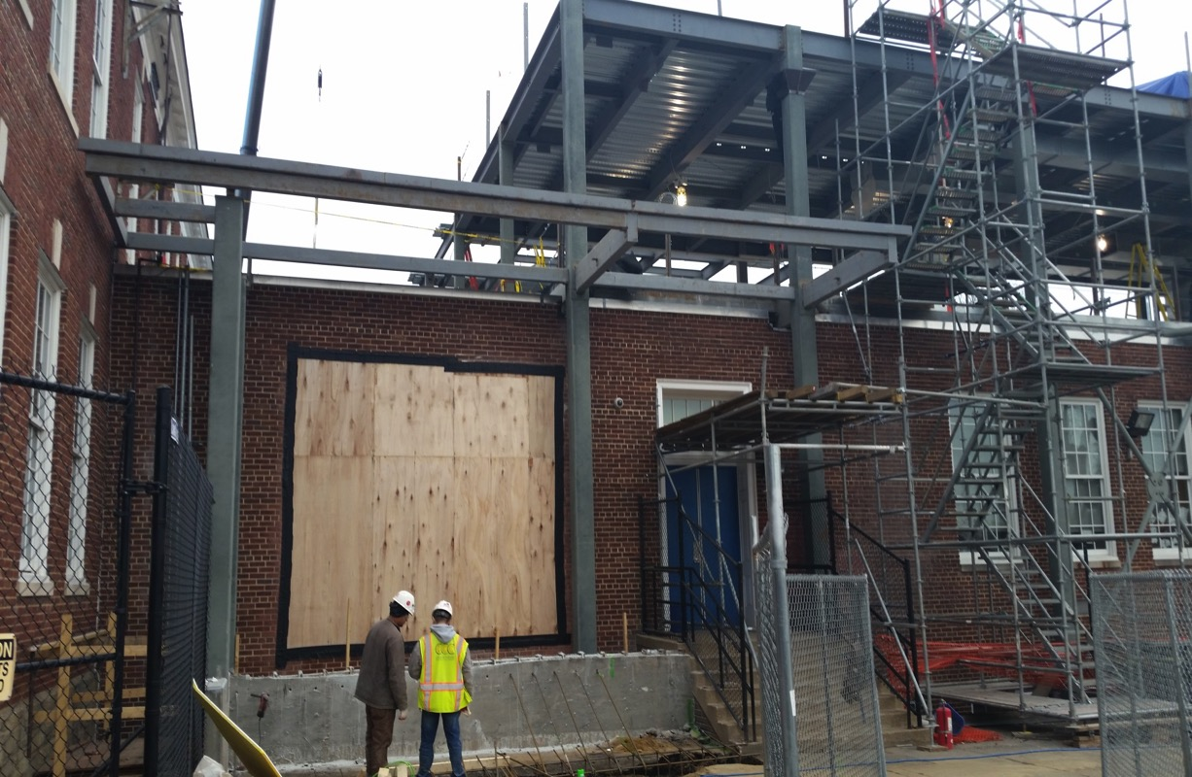
Playground Entrance Steel and Opening Installation

Slide 26
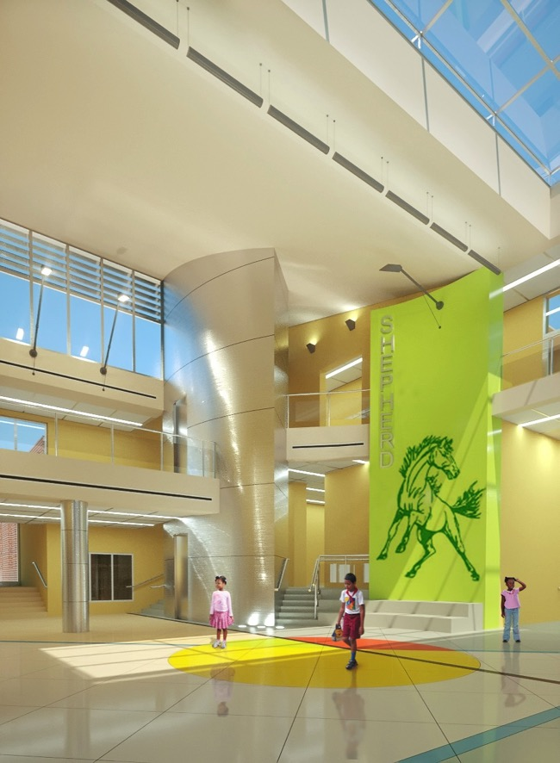
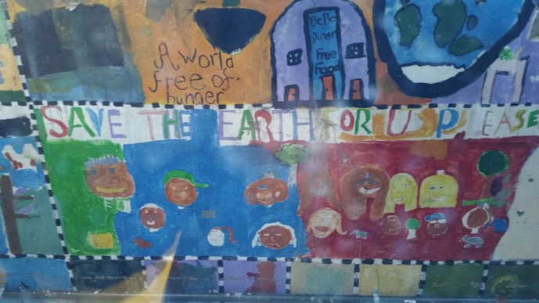
Shepherd ES Logo in Courtyard & Mural

Slide 27
Elevating the Quality of Life in the District
Elevating the Quality of Life in the District
NEXT STEPS TWO WEEK LOOK AHEAD
EXCAVATION on Infiltration Trench at South Site
Excavation of sprinkler main line parking area
FORMING & INSTALLATION OF CONCRETE SLAB IN COURTYARD
ERECTION OF STRUCTURAL STEEL IN COURTYARD AND 1956 BUILDING
INSTALLATION OF 1956 ADDITION EXTERIOR FRAMING

Slide 28
Elevating the Quality of Life in the District
Kenneth Diggs
DGS Associate Director
DGS Government Affairs & Communications
kenneth.diggs@dc.gov
(202) 580-9361
Get Social with us on Facebook & Twitter Today!
Follow @DCDGS
Become a Fan @DC Department of General Services

